Slide 1
Notes:
Welcome, my name is ,
and it is my great pleasure to be your host for this session of the series, “Discovering the Divine Principle, Principles of Restoration, part 2.”
In review– history has a goal. After Adam and Eve fell, the key step that is needed, in order to restore God’s ideal of creation, is for God to send the Messiah as

Slide 2
Notes:
the new Adam. If that person overcomes the temptations of this fallen world and is able to stand as God’s true son, together with his bride, in the position of Eve, he will be able to establish a family in which God’s ideal is realized. Through that family

Slide 3
Notes:
all people will be able to return to God and participate in God’s ideal of creation.

Slide 4
Notes:
In this session we will look at God’s effort to prepare for the Messiah in Adam’s family, Noah’s family and Abraham’s family.

Slide 5
Notes:
the Messiah, God requires that we, fallen humanity, fulfill our portion of responsibility. What is our portion of responsibility? It is to reverse what took place in the Fall. We gave that a name – we called it indemnity.

Slide 6
Notes:
To go further into detail, God will choose

Slide 7
Notes:
a central person to represent humanity, who can take on the task of making the condition of indemnity to reverse the Fall. In Adam’s family that person was Abel.

Slide 8
Notes:
We learned that this indemnity condition to reverse the Fall includes 2 steps.
Number one, the central person must make a condition of faith.

Slide 9
Notes:
They must demonstrate their faith in God by making an acceptable offering. Abel did this by

Slide 10
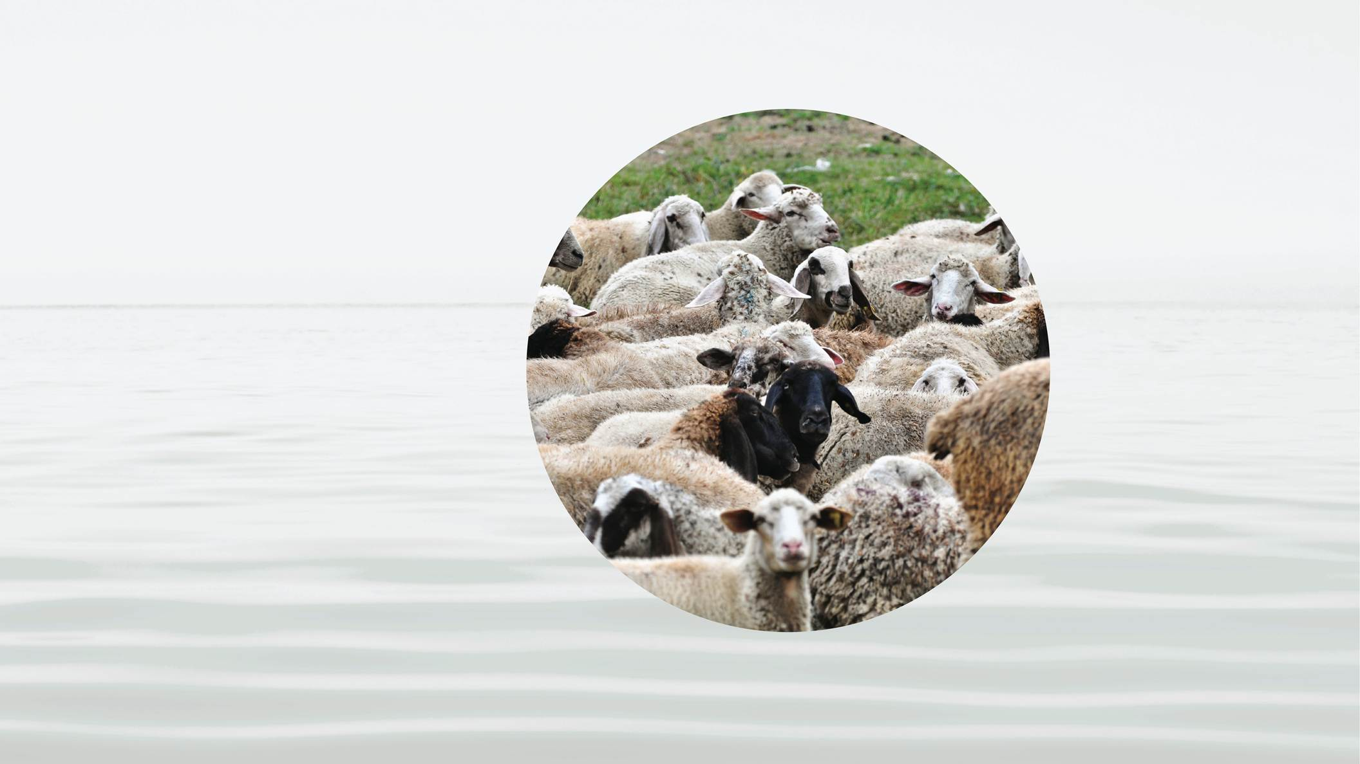
Notes:
offering the best of his flock.
Number two,

Slide 11
Notes:
the Central Person, representing God’s position, must interact with someone who represents the Archangel, in such a way that they

Slide 12
Notes:
reverse what took place in the Fall. This means that the person in the position of the Archangel must not kill the Central Person. Instead, they must be led to overcome their fallen nature and to unite with and support

Slide 13
Notes:
God’s Central Person.

Slide 14
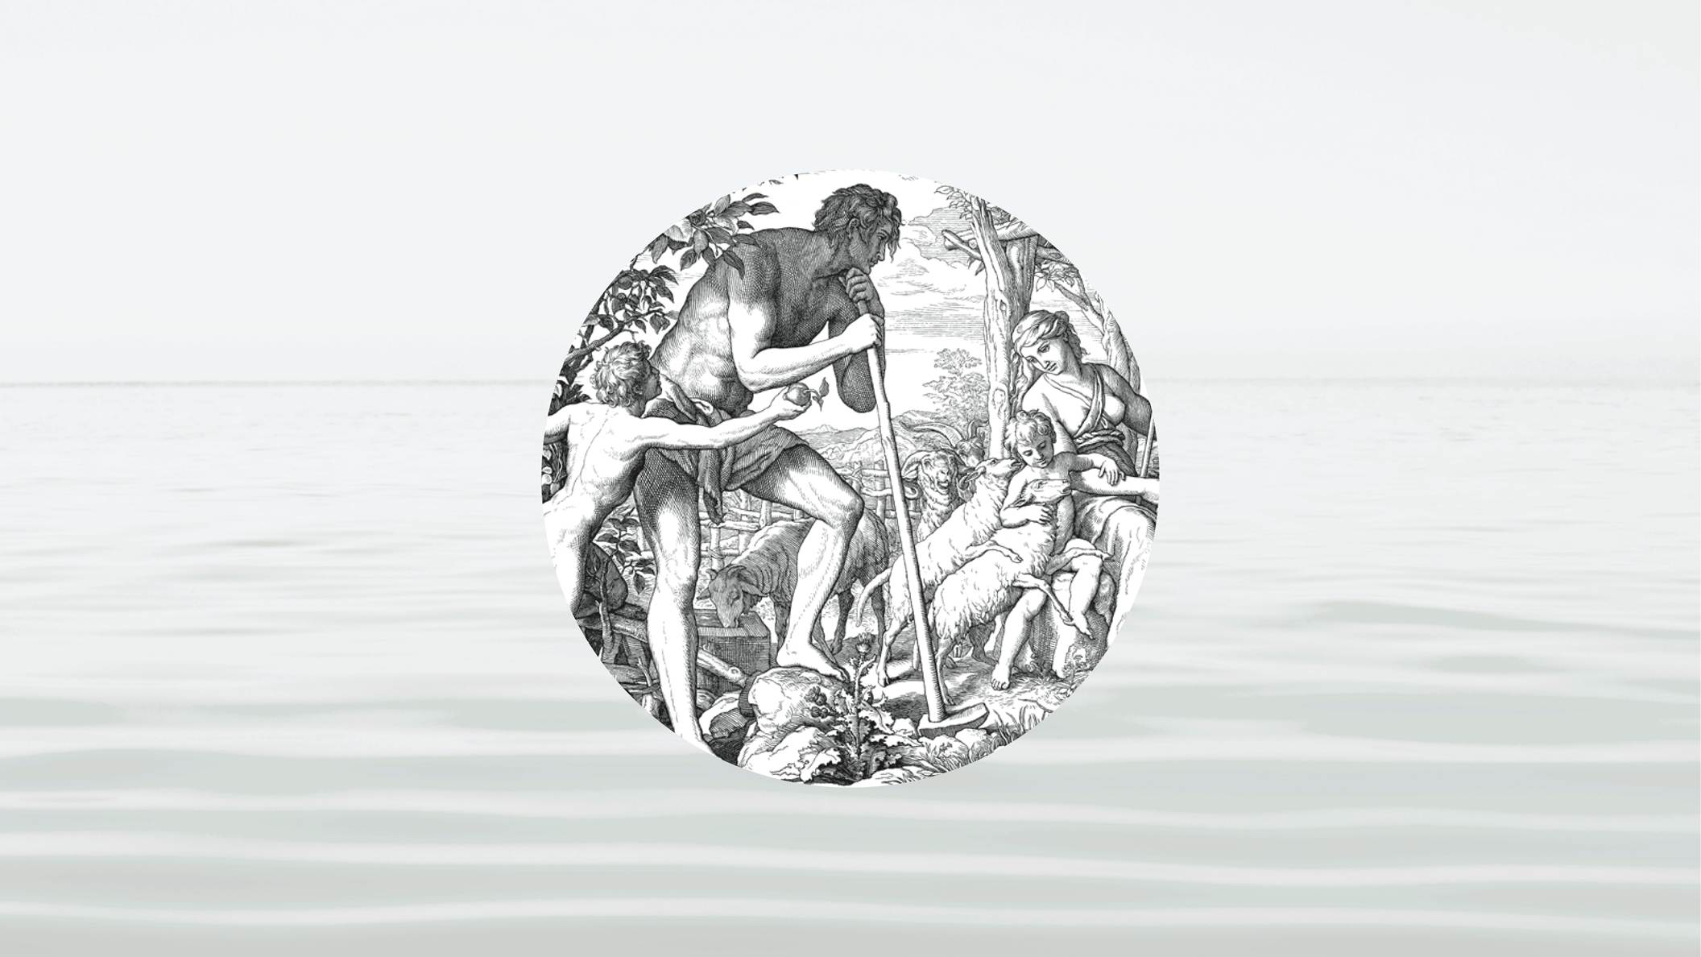
Notes:
In Adam’s family Abel, the younger son, represented God’s position. Cain, his older brother, represented the Archangel.
God loved both Cain and Abel, but He needed Cain to love Abel to overcome the Fall.
Tragically Cain could not follow God’s advice and he

Slide 15
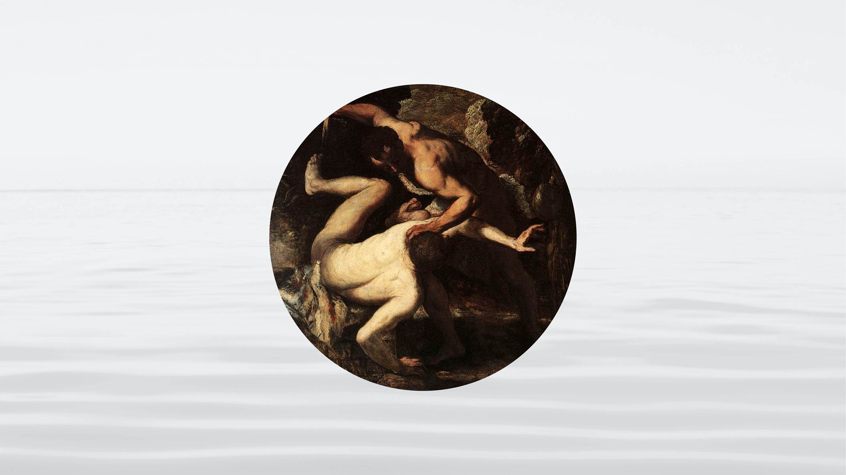
Notes:
murdered Abel. Instead of reversing the Fall, the fall was repeated.
After Cain murdered Abel it was many generations before God was able to find someone else through whom He could work.
Finally God found

Slide 16
Notes:
Noah. The story of Noah, the Ark, and the flood is well known. It is often considered to be nothing more than a myth or a story for children. However, the story of Noah reveals God’s urgent desire to send the Messiah. With Noah’s family God made His second attempt to prepare a foundation upon which He could send the Messiah by establishing the necessary indemnity conditions.
The first condition, which is the condition to restore Adam and Eve’s lack of faith was fulfilled by Noah when he

Slide 17
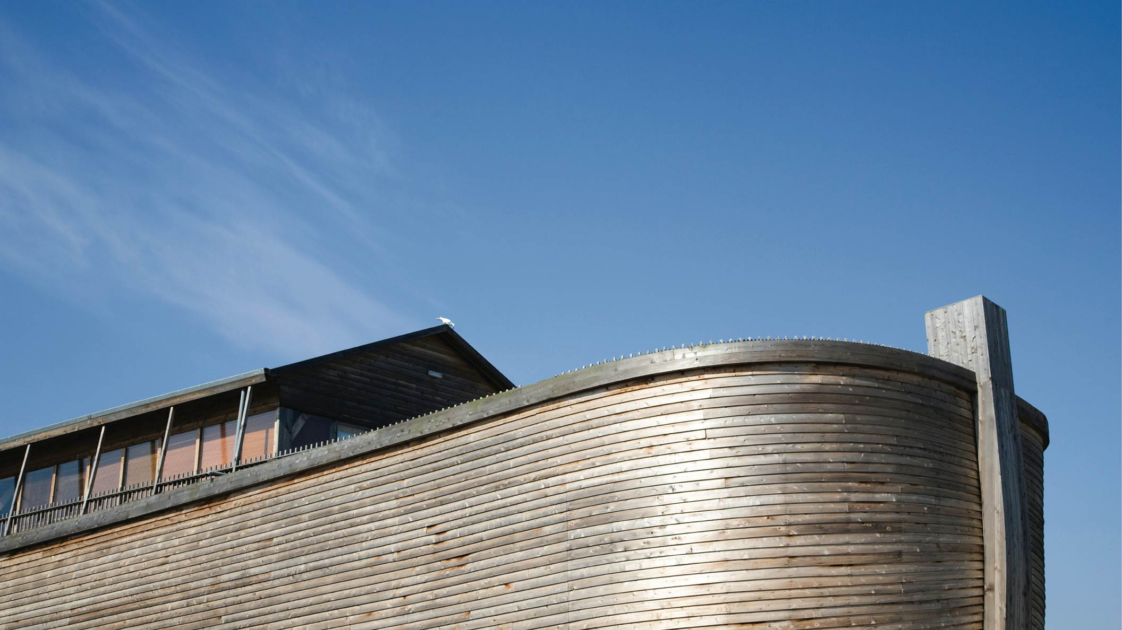
Notes:
built the ark. He persevered through years of ridicule and even his family thought he was crazy. But Noah never gave up and because he built the ark, his family, including his 3 sons and their wives were saved.
After the flood had passed and Noah’s family had settled once again on the land, God wanted to send the Messiah to Noah’s family, but first,

Slide 18
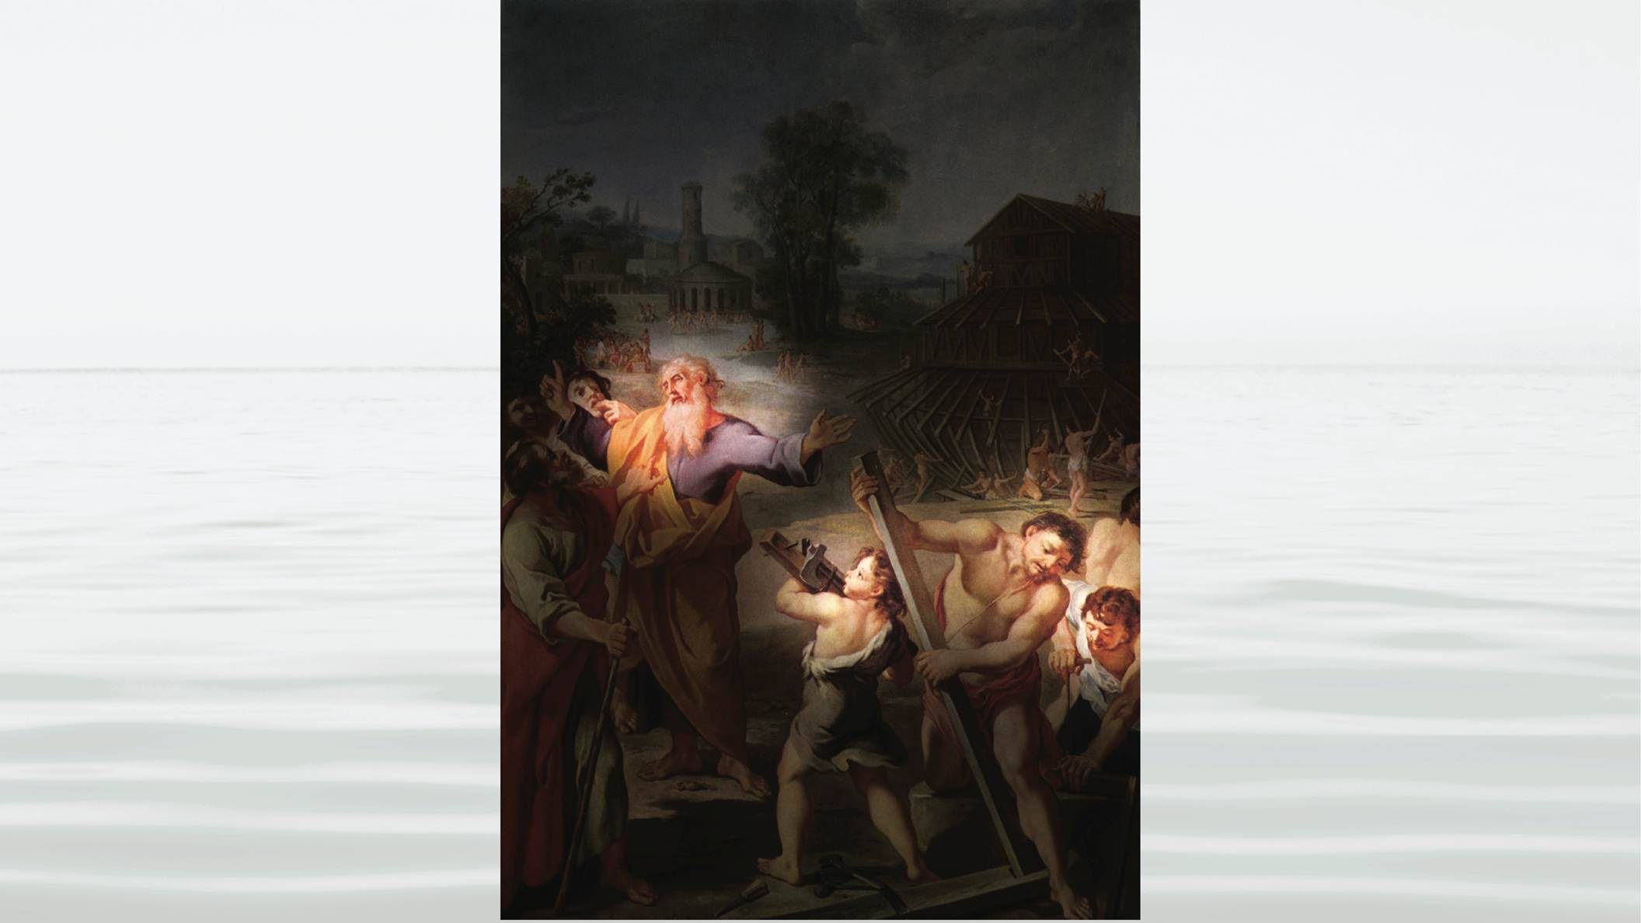
Notes:
Noah’s sons had to fulfill the indemnity condition to reverse the Fallen Nature, and in so doing complete the foundation for the Messiah.
Ham, who was the second born son, was to unite in heart with his father, then together, they would help his older brother, Shem, overcome his fallen nature.
Sadly, Ham could not believe that his father was in God’s position. On one occasion

Slide 19
Notes:
Noah became drunk and fell asleep naked in his tent.

Slide 20
Notes:
Ham walked into the tent, and felt ashamed instead of respecting his father. He then convinced his brothers that Noah had done something sinful. They then took a blanket,

Slide 21
Notes:
and walking backwards, covered him.
When Noah awoke, he cursed the descendants of Ham. Noah’s family came to reflect the fallen nature instead of God’s nature. This is why God was unable to send the Messiah to Noah’s family.
God had wanted to make a new beginning through Noah’s family. He removed the surrounding civilization through

Slide 22
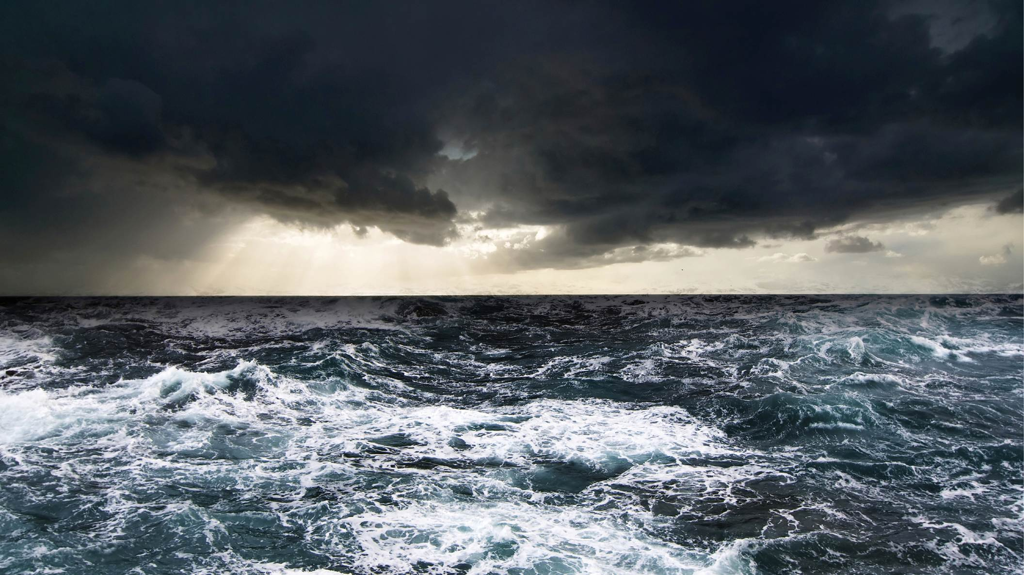
Notes:
the flood so that Noah’s family could prepare the foundation for the Messiah without interference. If God could have sent the Messiah to Noah’s family, Noah’s family could have been restored, and the sin of Adam of Eve could have been removed. From that point

Slide 23
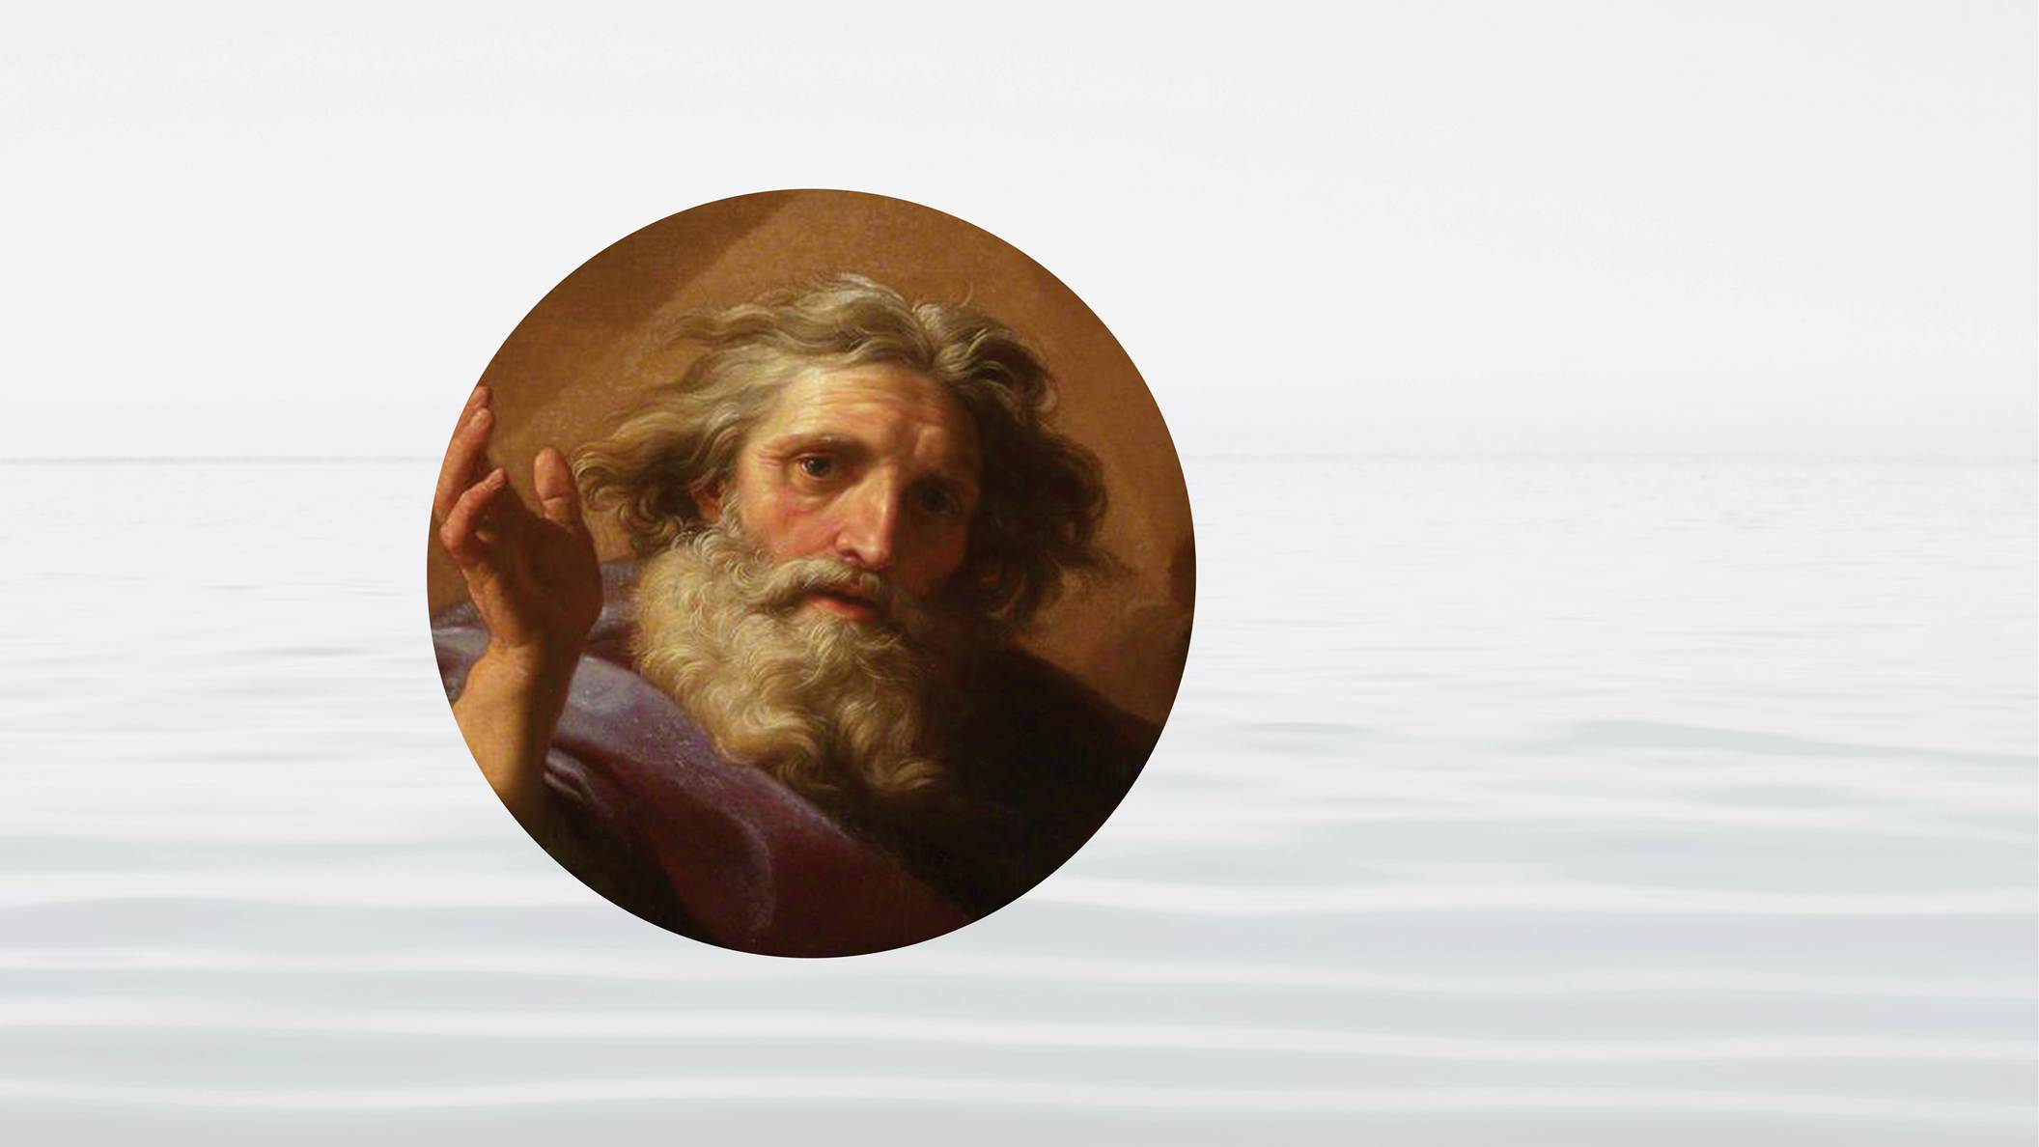
Notes:
God’s Ideal, a world of goodness, could have emerged.
After Noah, God waited

Slide 24
Notes:
400 years before calling another Central Person who would be able to prepare a foundation for the Messiah. The person he called was Abraham. Abraham’s family was God’s 3rd attempt to prepare a foundation upon which He could send the Messiah. God called

Slide 25
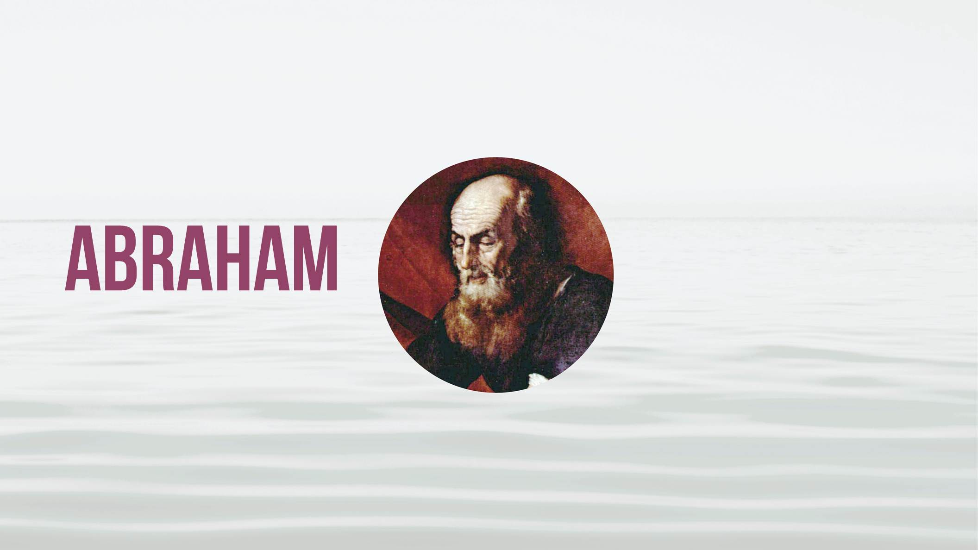
Notes:
Abraham to leave his home, guiding him to the land of Canaan. There God made a covenant with Abraham. God intended to bless Abraham’s family and from his family raise up a great people who would be able to receive the Messiah. Once again, a family, this time Abraham’s, was to prepare a foundation for the Messiah.
God asked Abraham to make an offering that consisted of dividing

Slide 26
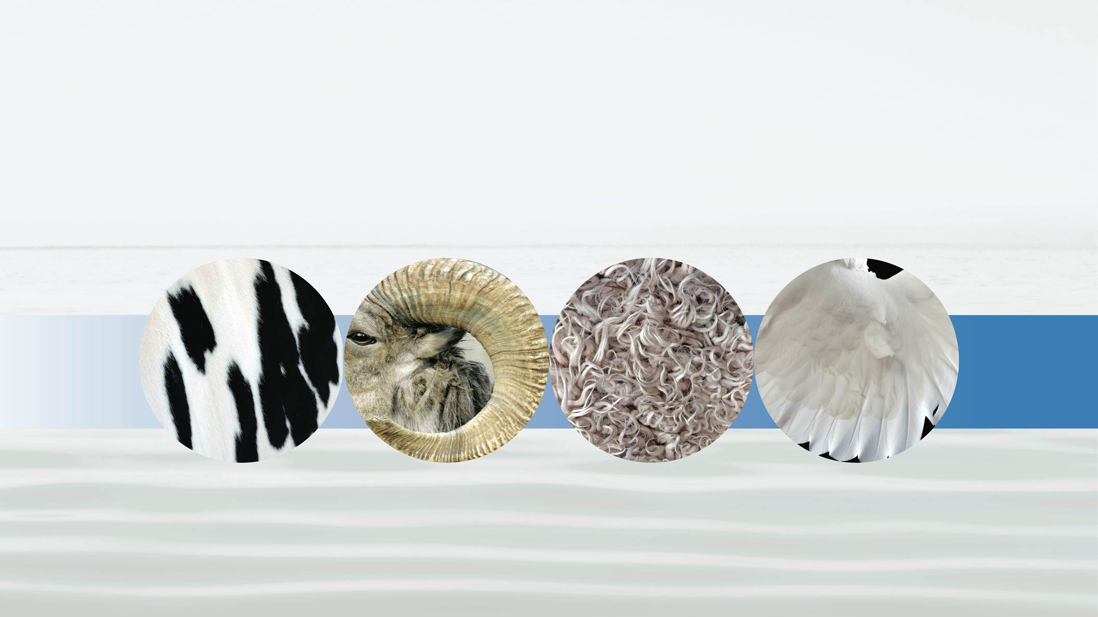
Notes:
a cow, a ram, a she goat, and two birds in half. He divided the cow and the ram and the she goat, but he did not divide the 2 birds. At that point Abraham fell asleep and upon awakening found

Slide 27
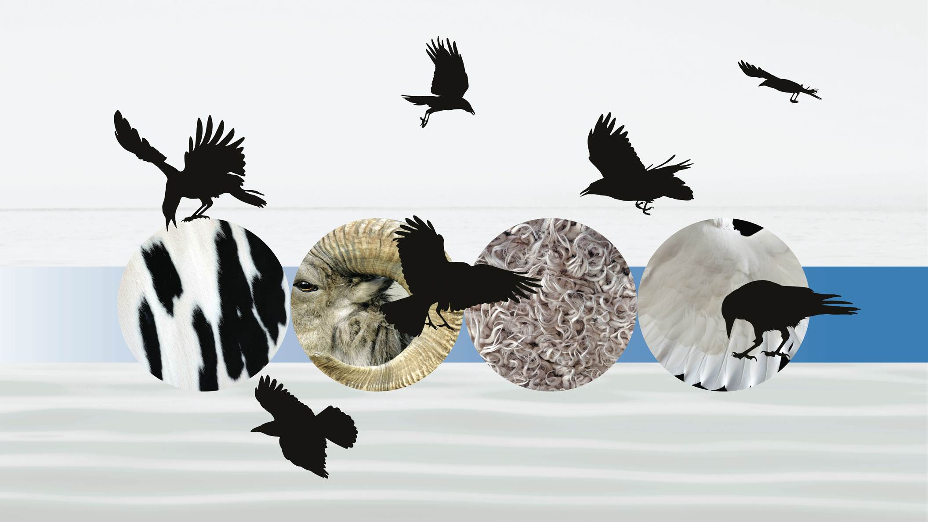
Notes:
birds of prey eating the offering. This was a sign, that Abraham’s offering was not acceptable. Abraham had failed to fulfill the foundation of faith for the coming Messiah.
What could God do? Although God does not usually give us a second chance, on the foundation of Abel’s offering and the offering of Noah, God called on Abraham to make a greater condition of faith.
He told him to offer

Slide 28
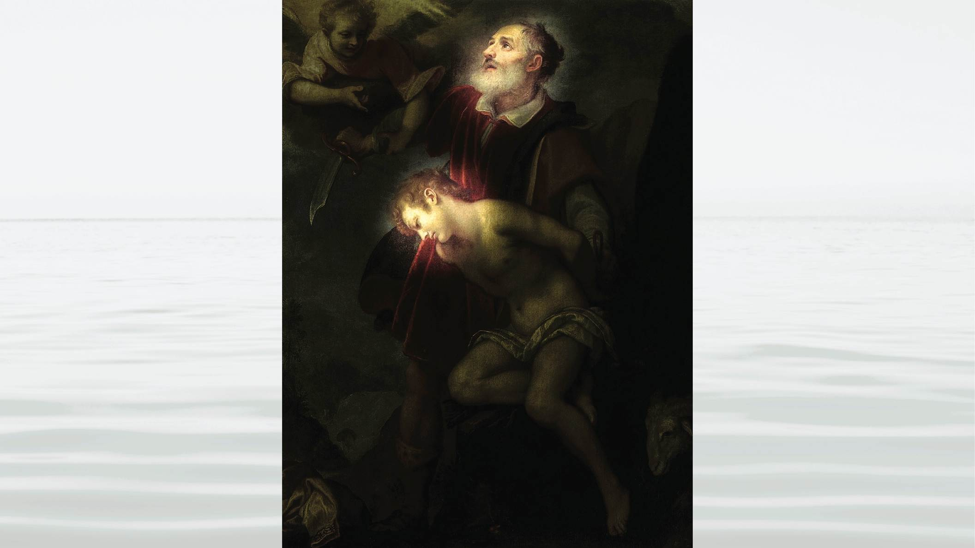
Notes:
his son, Isaac. It would have been easier for Abraham to take his own life – and so, in being willing to offer Isaac, Abraham died and was born again through Isaac’s faith. Not only is Abraham willing to offer Isaac, but Isaac, because of his deep trust and love for his father, was a willing offering. This is one of the most remarkable stories of the Bible. When God sees Abraham’s faith, he sends

Slide 29
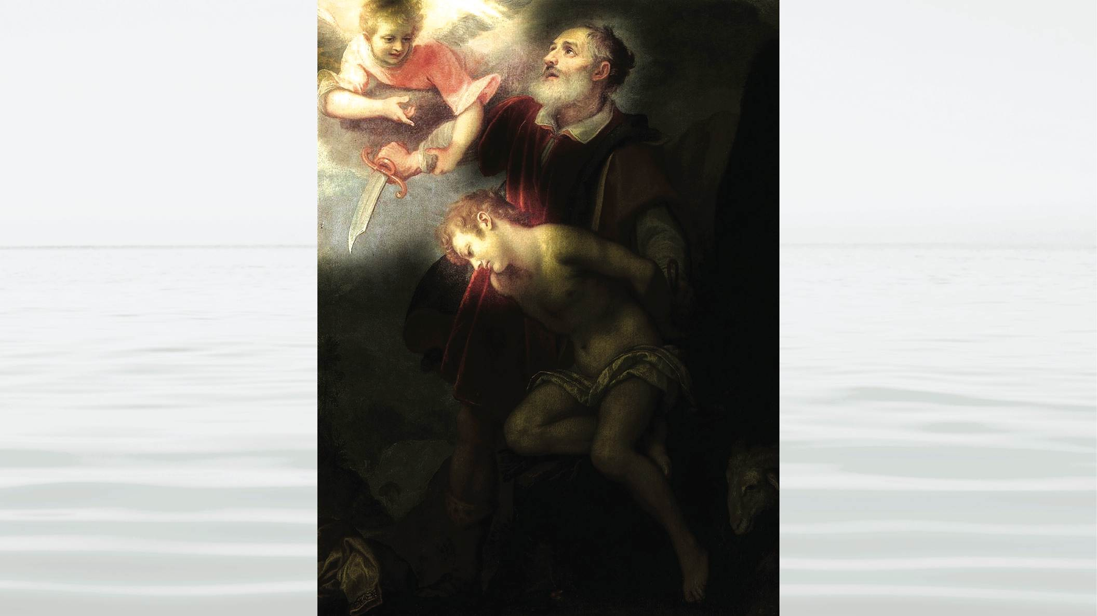
Notes:
an angel to stop him from killing Isaac.
Then Abraham and Isaac found

Slide 30
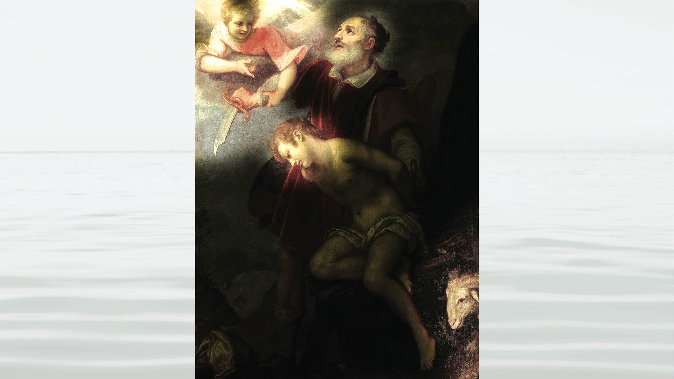
Notes:
a ram caught in a thicket, and they offered the ram to God. This became the offering that fulfilled the indemnity condition of faith in preparation for God to send the Messiah.
For the condition to reverse the fallen nature, again God would work through 2 brothers, one elder in the position of the Archangel and one younger in the position to represent God’s side. These were Isaacs 2 sons, Esau and Jacob.

Slide 31
Notes:
Esau was the first-born, and like Cain, he represented the fallen lineage of the Archangel. Jacob was the 2nd born, representing God’s side. In this story we begin to see the important role of women in God’s providence. Their mother, Rebecca, recognized that Esau, the elder son, was not good. She realized that if the blessing went from Isaac to him, it would be lost. And so she focused on Jacob, and raised him, guiding him to seek the position of his elder brother.

Slide 32
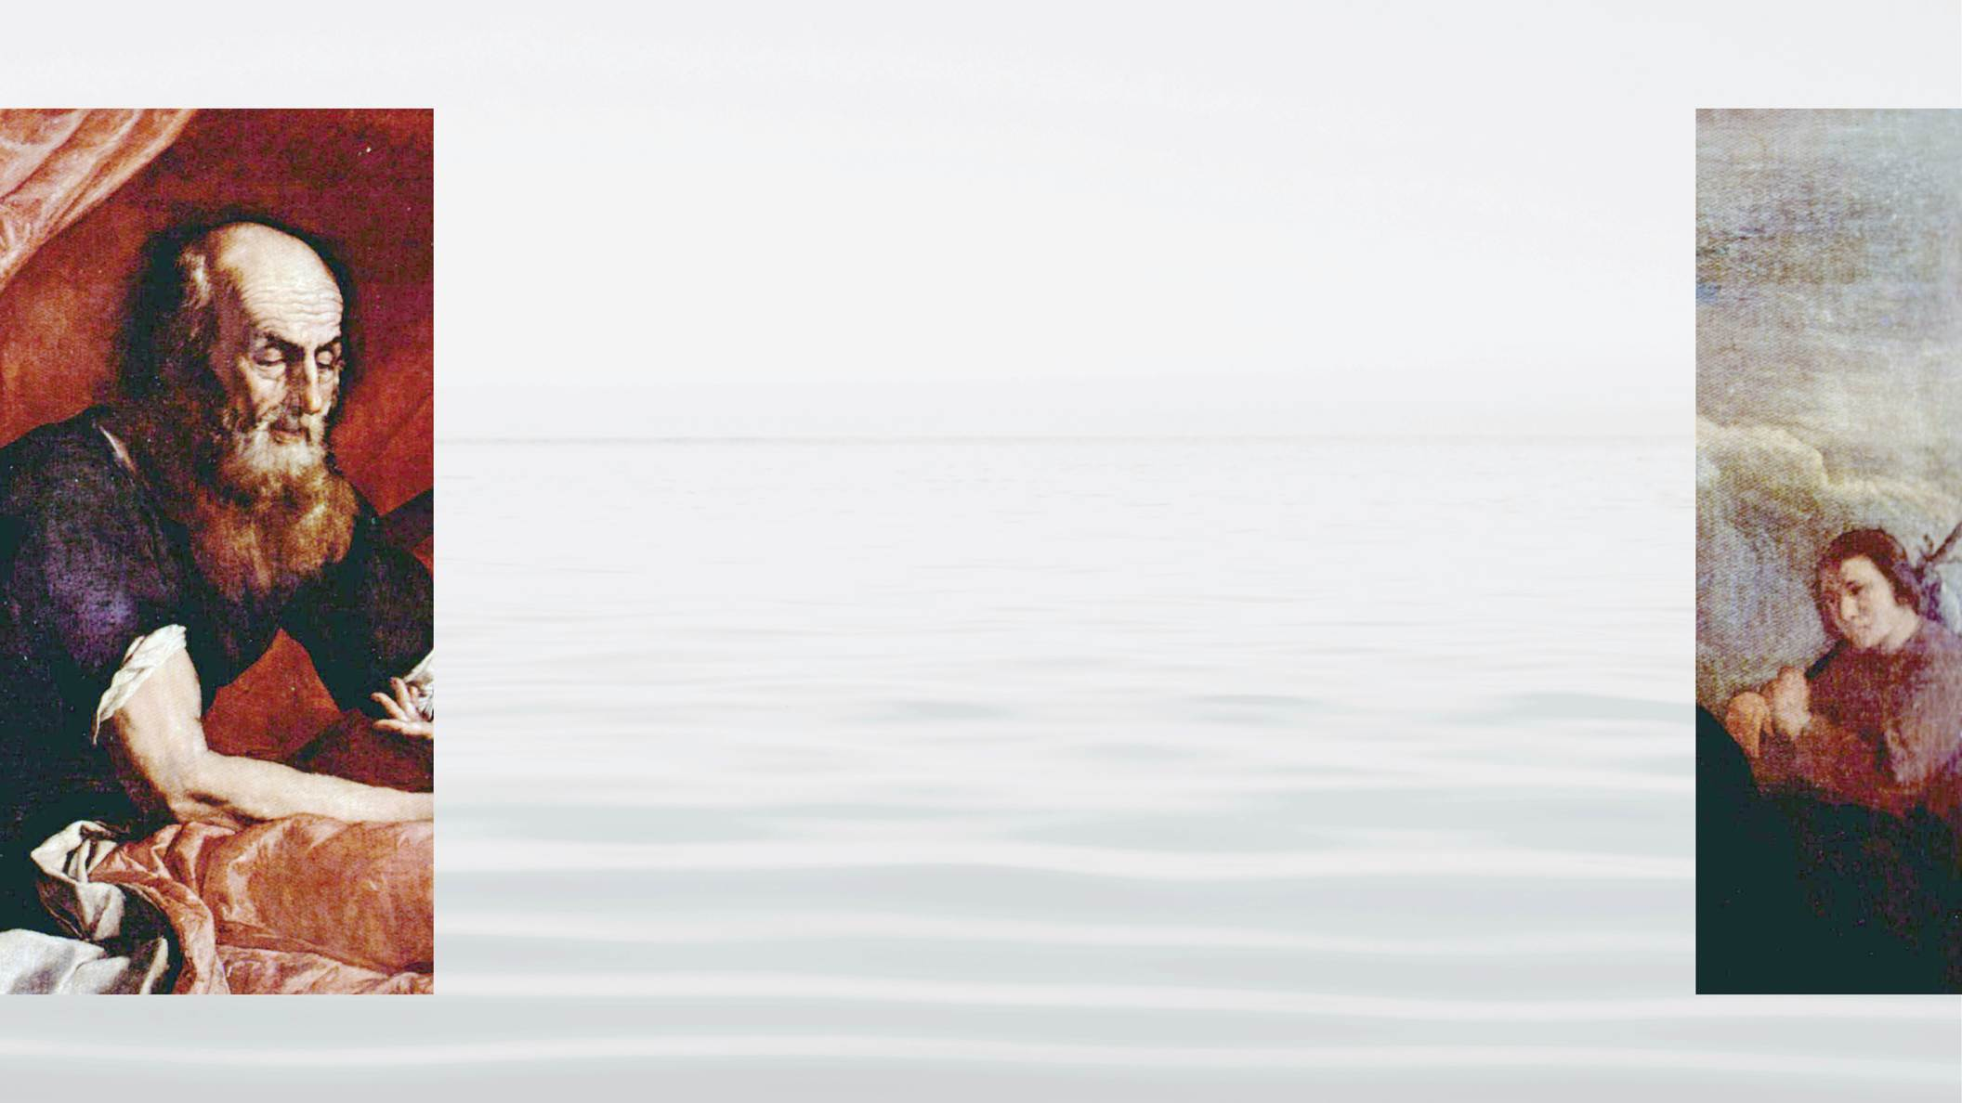
Notes:
One day Esau came back from an unsuccessful hunting trip. He was extremely hungry and he demanded food from Jacob. Jacob saw it as an opportunity and asked his brother to allow him to take the position of first-born in exchange for some bread and lentil soup.

Slide 33
Notes:
Later, in his old age, Isaac called Esau and told him that he will give him the blessing if he will go out and catch the wild game and prepare him a meal. But

Slide 34
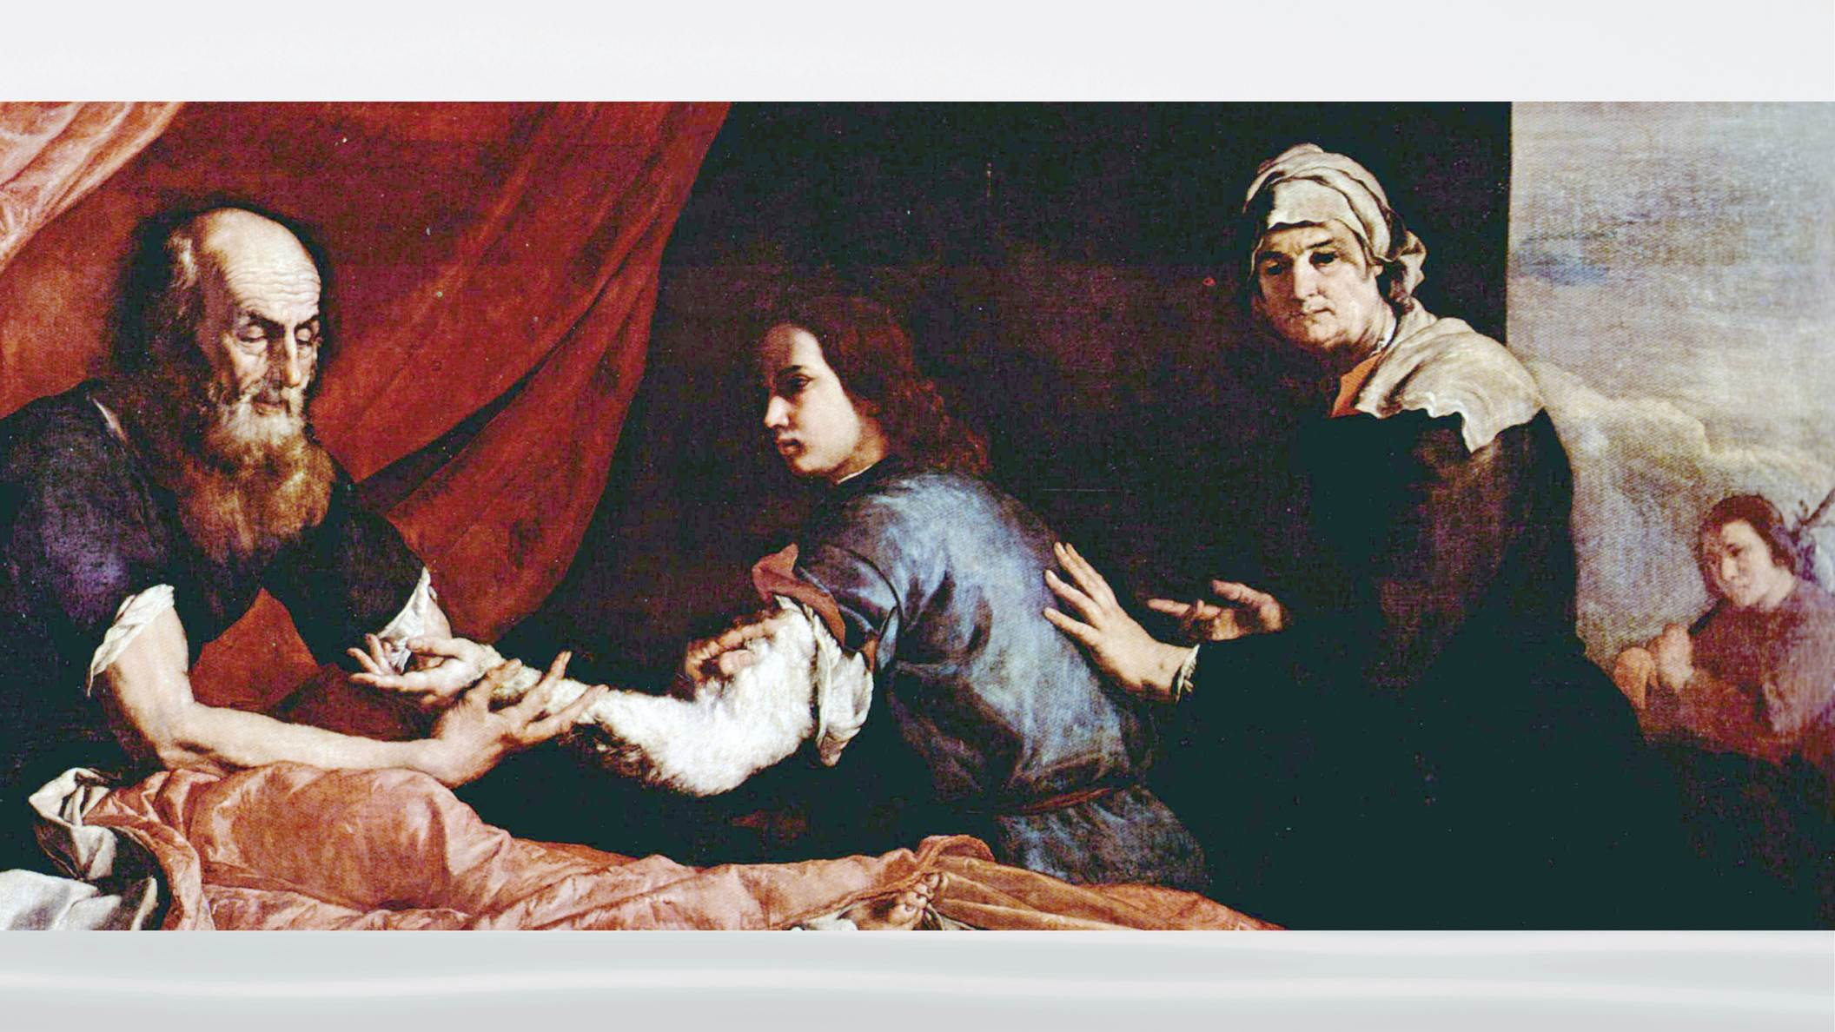
Notes:
Rebecca sent Jacob to Isaac, with the meal, dressed to look like Esau. Isaac, in his old age, was almost blind and did realize it was Jacob, and so he gave the blessing to Jacob.

Slide 35
Notes:
When Esau learned what had happened he became furious and he made a pledge that he would kill his brother. Rebecca, then told Jacob to run away and go live with his

Slide 36
Notes:
Uncle Laban.
Jacob lived under his uncle for 20 years. His uncle took advantage of him repeatedly. God eventually blessed Jacob with great wealth, commanding him to return to his brother on the 21st year of exile.

Slide 37
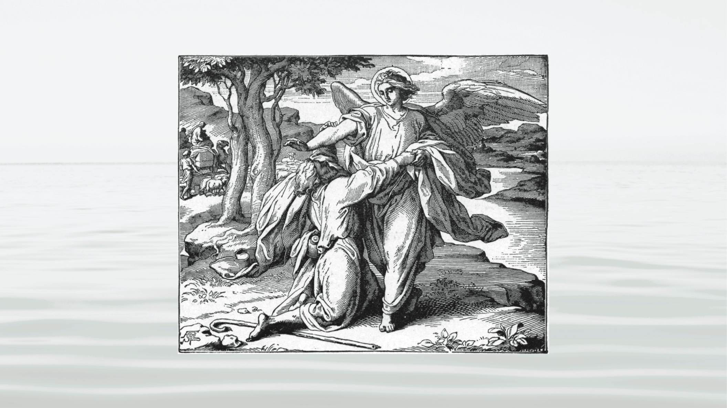
Notes:
On the way God send an angel to block his way, is giving him the opportunity to restore the dominion over the angels. All night Jacob wrestled with the angel, but finally the angel struck Jacob the hollow of his thigh – close to that part of the body that caused Adam to sin. The angel then told Jacob to release him, but Jacob answered, “I will not release you, unless you bless me!” And the angel blessed Jacob and changed his name from Jacob to Israel.
The next day Jacob, (now Israel) went on to meet his

Slide 38
Notes:
brother Esau. With amazing humility Jacob offered absolutely everything he had to his brother, and they finally embraced.
This was one of the great moments in human history. For the first time, God was able to find a family, men and women working together, who were able to fulfill the human portion of responsibility.

Slide 39
Notes:
They accomplished the conditions of indemnity to reverse what happened in the Fall. Abraham and Isaac established the condition of faith and with the help of Rebecca, Isaac’s sons, Esau and Jacob, were able to reverse the fallen nature. It is because of this accomplishment that God could send the Messiah to Jacob’s descendants.
At this point you may ask

Slide 40
Notes:
“why didn’t the Messiah come?” It wasn’t until 2,000 years later that Jesus was born in Israel. There are 2 reasons:
First, at the time of Adam and Noah, God just needed to restore one

Slide 41
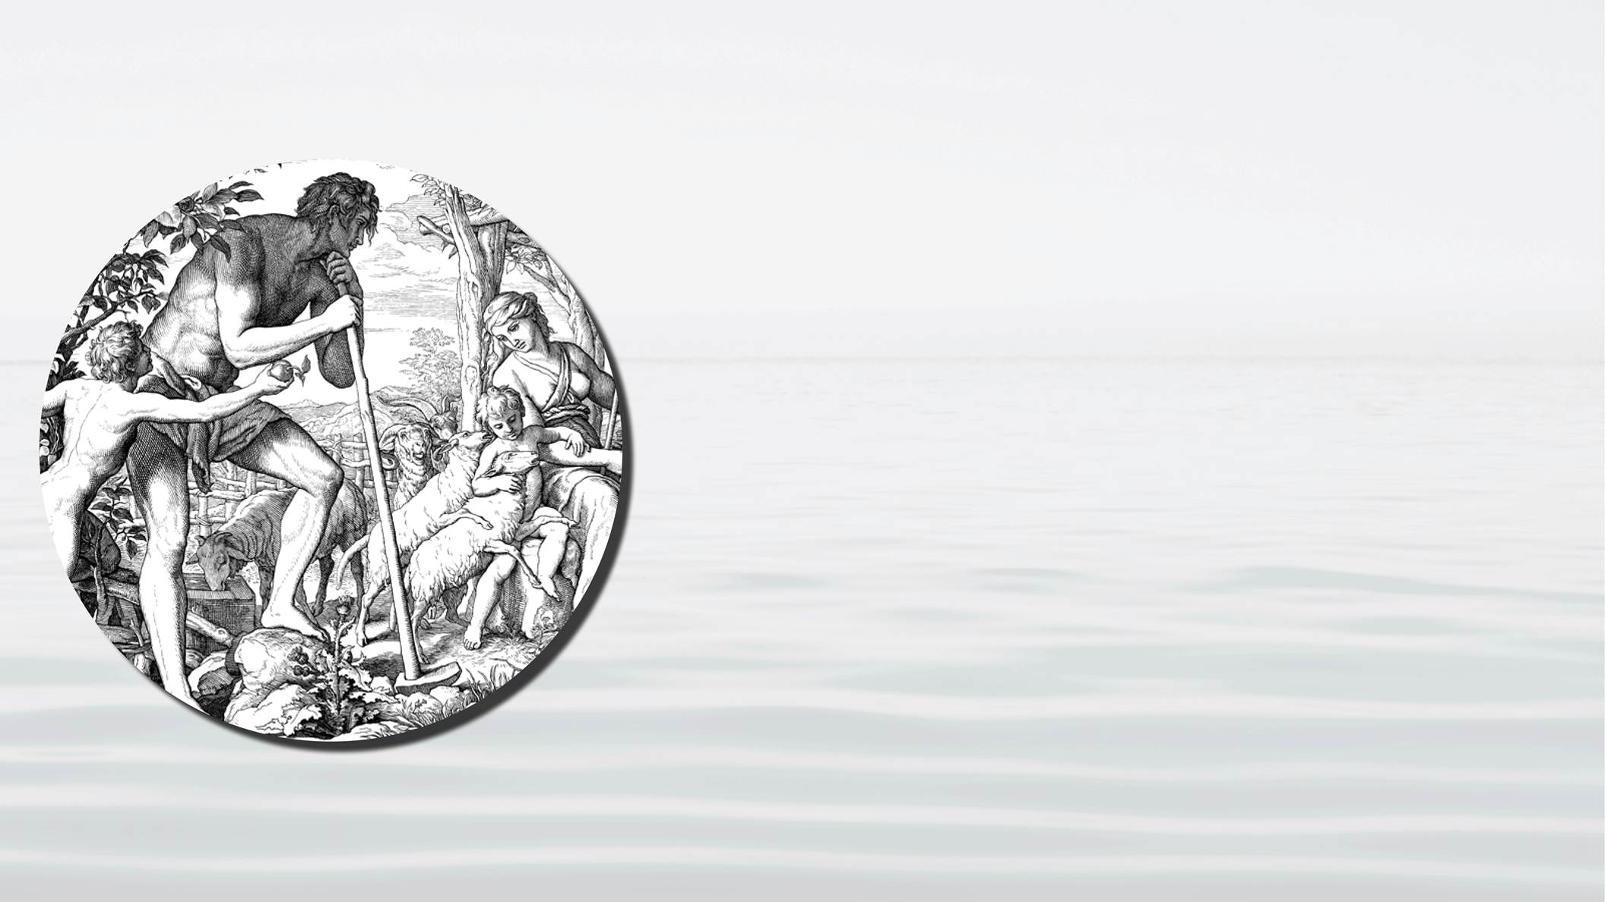
Notes:
family – that would have been enough. But after Noah, God had to deal with

Slide 42
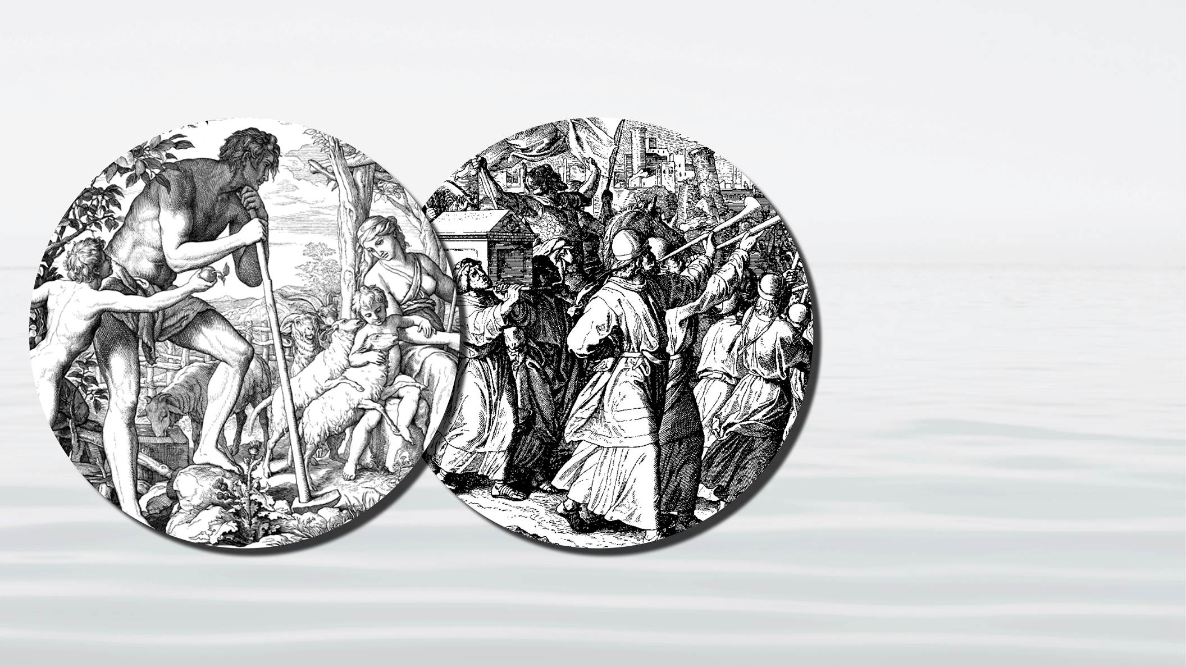
Notes:
the kingdoms and empires of the fallen world. This meant that preparing a family foundation for the Messiah was no longer enough. If the evil world has kingdoms and empires with vast armies, a family will be unable to protect the coming Messiah. For this reason God must prepare

Slide 43
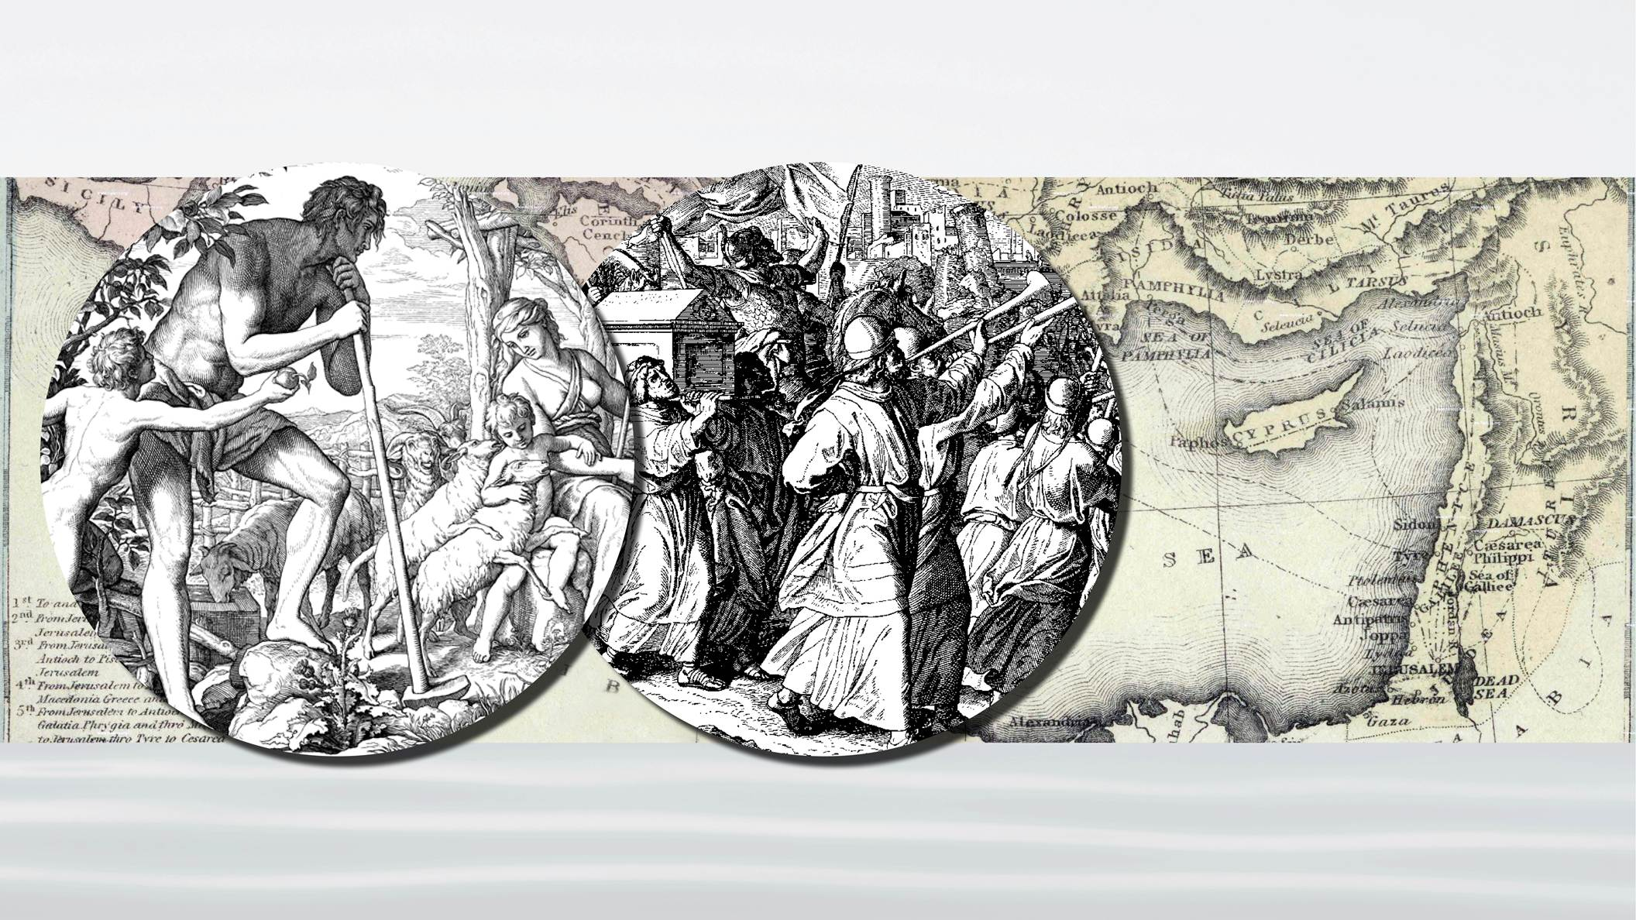
Notes:
a nation before He can send the Messiah. Therefore after Abraham, Isaac, and Jacob’s victory, God began to plan for the preparation of a nation to receive the Messiah. This would be the mission of Moses.
The second reason the Messiah did not come for 2,000 more years is that the preparation of a nation did not go well.

Slide 44
Notes:
The Israelites, as a people, had a hard time to overcome their fallen nature. It was difficult for them to support and follow the Central Persons God called to represent Him.

Slide 45
Notes:
They turned against Moses, the commandments, and the prophets that were sent to them by God.

Slide 46
Notes:
What are the lessons to be learned from God’s effort in Adam’s Family, Noah’s family, and Abraham’s family to prepare a place where God can send the Messiah?
First, we learn that

Slide 47
Notes:
God is working to restore his children according to a clear set of principles. And if we can understand those principles, we can understand how God is working in our individual lives to prepare us.

Slide 48
Notes:
Secondly, we can see God’s unchanging love for us. His absolute determination to save His fallen children. No matter how many times we fail, God does not give up.

Slide 49
Notes:
And finally, we can see how important it is that people fulfill their portion of responsibility. God loves us and is working to save us, but we have responsibility. Our part is to first demonstrate faith in God and second is to overcome our fallen nature, our tendency to rebel, and support that person whom God has chosen to represent him.

Slide 50
Notes:
Thank you for joining us. In the next session we will take a look at the history leading up to the birth of the Messiah, Jesus, and then compare that to the history leading up to the return of Messiah, what is called the Second Coming. I think you will find it quite amazing.

