Slide 1
Notes:
Welcome, my name is ,
and it is my great pleasure to be your host for this session of our series, Discovering the Principles of Life, How the Messiah Is Saving Humanity
The content that I will be presenting is based on the chapter “Christology”, in the Divine Principle. The Divine Principle is a revelation from God that was given to the Rev Sun Myung Moon.
In the previous session on the Second Coming, we explained that

Slide 2
Notes:
the Messiah must now be on the earth. This session which you are about to watch will be especially interesting because I will be sharing with you who the Messiah is and how

Slide 3
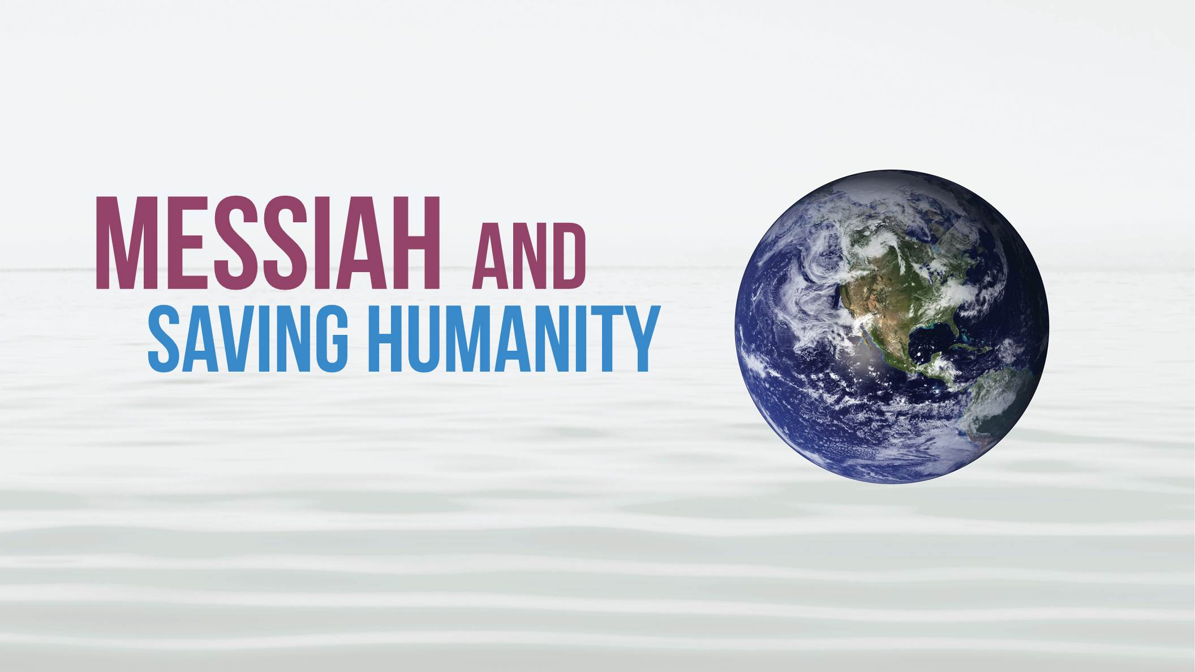
Notes:
he is saving humanity.
Who is the Messiah? Is he

Slide 4
Notes:
God? Is he

Slide 5
Notes:
man? Is he both? Some have imagined him to be one in the same with God the creator, possessing supernatural powers. Others have portrayed him as a man, no different than other men, other than the fact that he was chosen by God to be the Messiah.

Slide 6
Notes:
We believe that Jesus, who was the Messiah, was a man – but different than other men in that he was, from­ birth, the son of God.
The best way to understand who the Messiah is and how he is working to save humanity, is to take a closer look at God’s

Slide 7
Notes:
original plan of creation.
In previous sessions we learned that the ideal of

Slide 8
Notes:
God’s creation, which God intended all humanity to fulfill, is a family rooted in God’s love.

Slide 9
Notes:
The first man, Adam, and the first woman, Eve, were to have fulfilled the first blessing by growing in heart to the point that they would be able to stand as the true son and daughter of God. Then, on that foundation of maturity in their relationship with God they were to have been blessed in marriage. God would have been present in their love as husband and wife and He would have also have been present in their children. This would have been God’s family

Slide 10
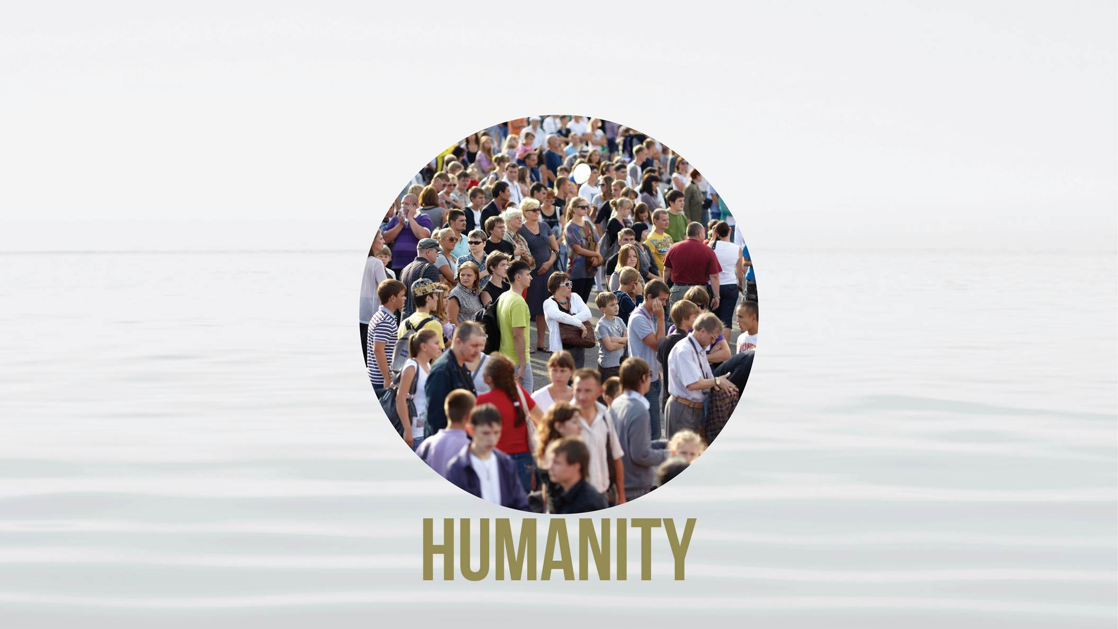
Notes:
and the children and future generations of that family, all would have been born in God’s love.
If this ideal had been realized with our first ancestors

Slide 11
Notes:
there would never have been a need for a Messiah. We would already be living as one family under God.
There would never have been a Jesus Christ.

Slide 12
Notes:
Originally, there would have been no need for religion.

Slide 13
Notes:
Every person would have experienced the love of God as God’s true child. As God’s sons and daughters, they would have possessed God’s value.
We also learned, in the session on the Fall why this Ideal was never realized. We learned that the first man and woman did not connect in heart with God. Instead,

Slide 14
Notes:
the fallen Archangel initiated a relationship of love with

Slide 15
Notes:
Eve based on jealousy, deception, temptation, and seduction.

Slide 16
Notes:
Eve extended that same false love to

Slide 17
Notes:
Adam and the three of them, forming a trinity, began a history of fallen love that would lead people to live in contradiction to their God given nature.
Adam and Eve never re-aligned themselves with God. Instead, their union became like a corrupted seed that multiplied to become the

Slide 18
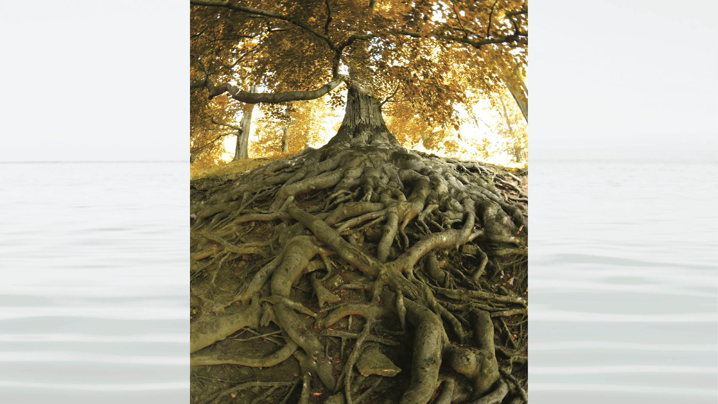
Notes:
present tree of fallen humanity. We were all born in a state of separation from God. Until now we have suffered in ignorance of our true situation, that we are members of a family that does not belong to God. This is why in John 8:44 Jesus taught that we are born of our father who is

Slide 19
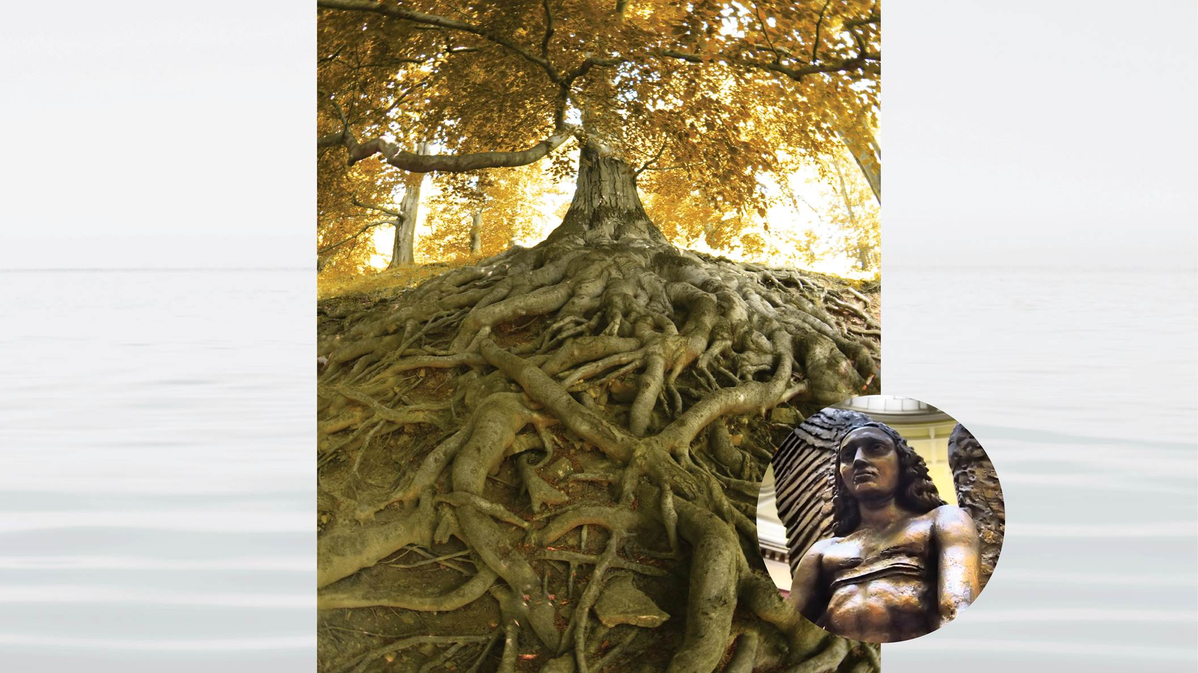
Notes:
the Devil. This is why we do not feel that we possess

Slide 20
Notes:
God’s value. It is why we do not experience God’s direct presence in our daily lives.
This means that to save humanity, which is the mission of the Messiah – all humanity, you and I, we need to change our birth. In other words, we need to change our lineage, we need to

Slide 21
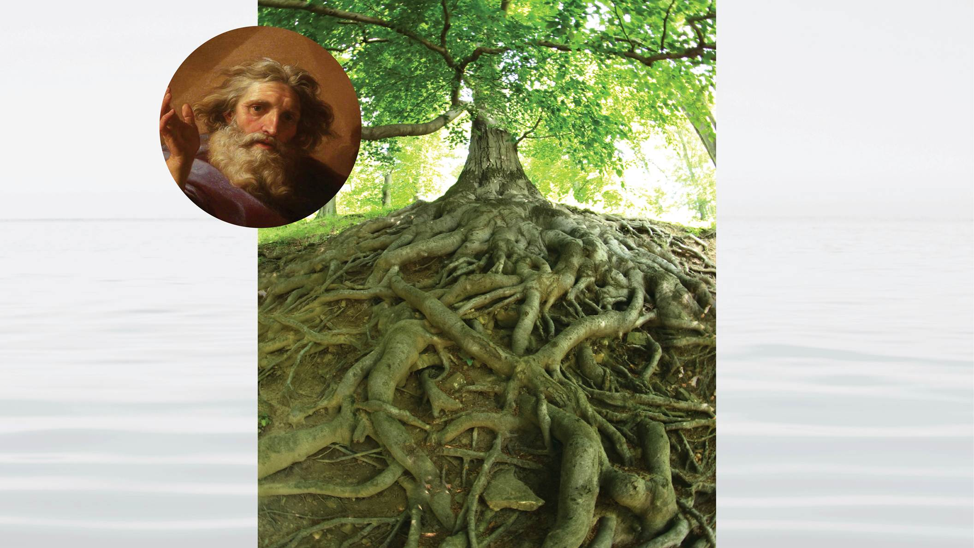
Notes:
move from being the descendants of the fallen tree, initiated by the fallen Archangel, and connect ourselves to the tree of humanity that is rooted in God’s love.
This is why Jesus taught (John 3:3) that if we are not born again we will never see the Kingdom of God. Paul understood this. In Romans 8:23 he taught that in the future, our salvation would be fulfilled, or completed,

Slide 22
Notes:
through adoption. Adoption, like re-birth, indicates that we need to change who our parents are, we need to be in a place where God can recognize us and relate to us as His children.
The problem is, Adam and Eve

Slide 23
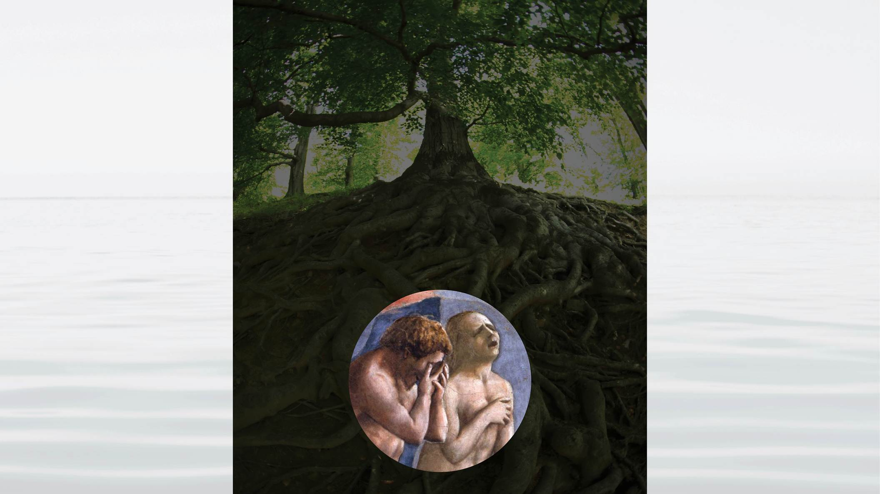
Notes:
did not create a family that God can claim as his own. There is no Human Family Tree that is rooted in God’s love. There has never been a family of God into which we could be adopted or through which we could change our birth. In order to create God’s family, God needs to have someone who stands as God’s true son. Who fulfills the position that Adam failed to fulfill.
That person, who is the son of God, is of course Jesus.

Slide 24
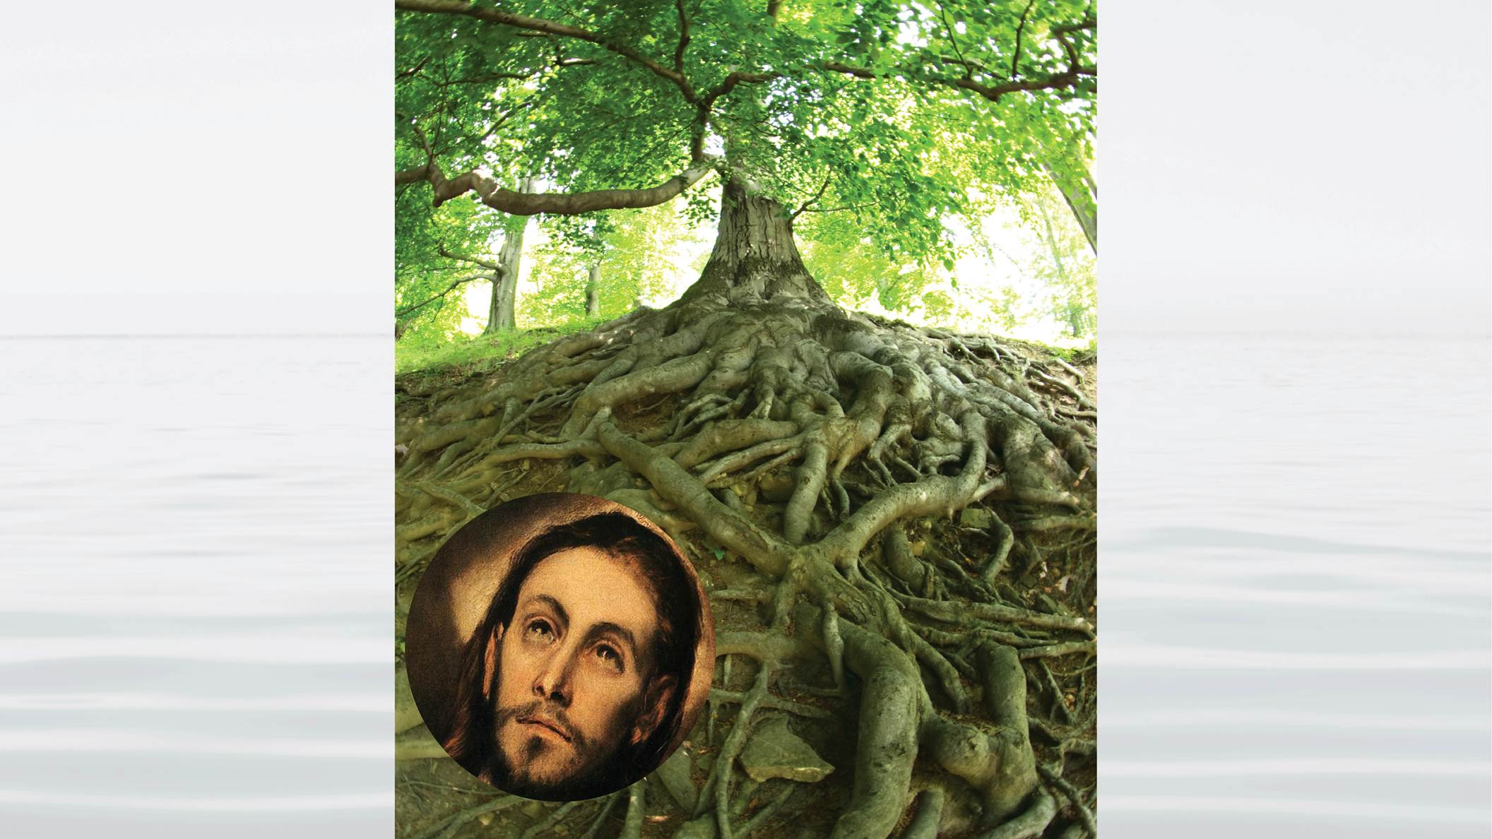
Notes:
Jesus is the Messiah. As the Messiah he was anointed by God to take the place of the first Adam and fulfill what the first Adam could not fulfill.
Most importantly – Jesus came to restore

Slide 25
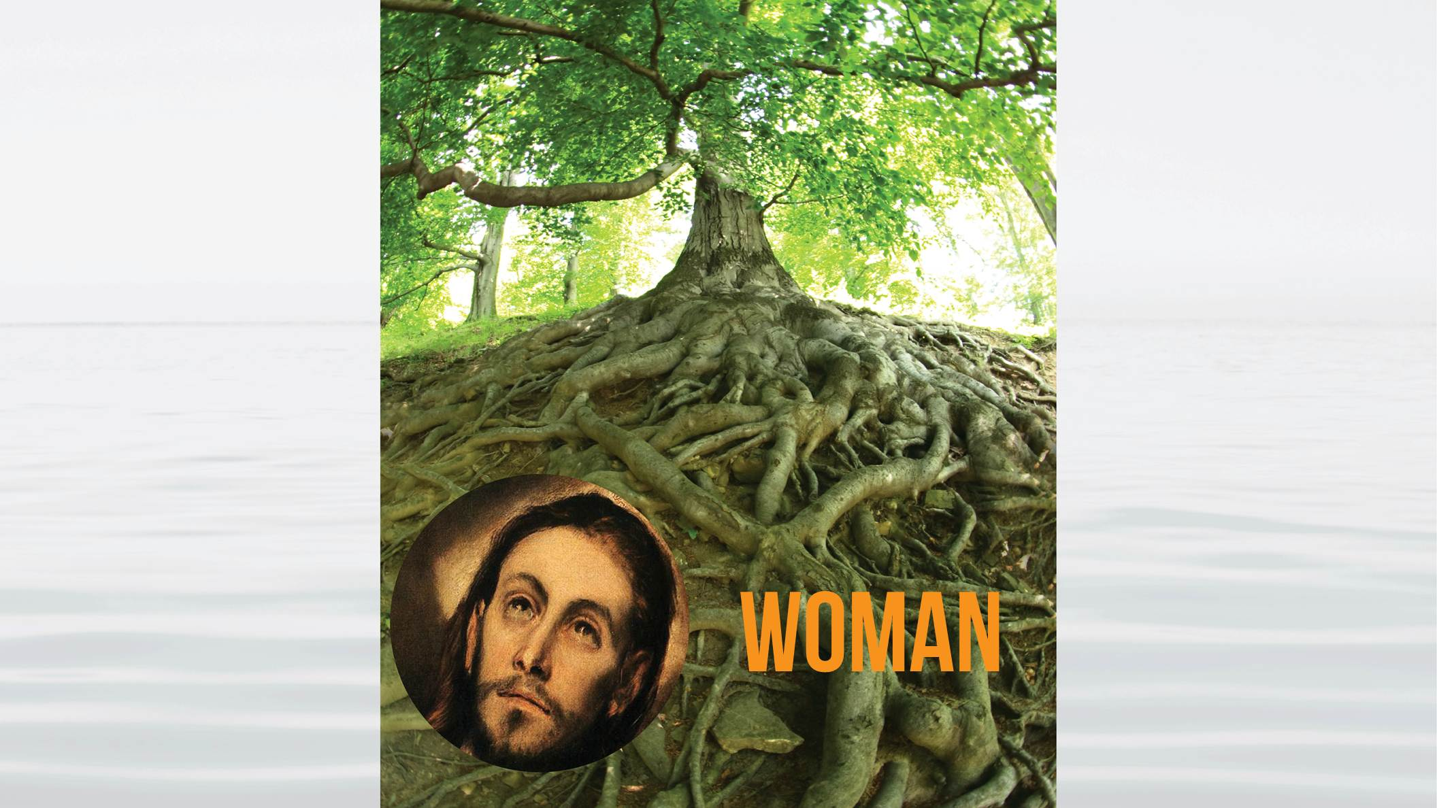
Notes:
a woman in the position that Eve was to have taken, as God’s true daughter. The image of God, as stated in Gen 1:27 is a man and woman. Jesus alone could not fully reflect God’s nature. He needed a woman to do that, and he needed a woman in order to form a family rooted in God’s love.
This means that Jesus is not the same being as the

Slide 26
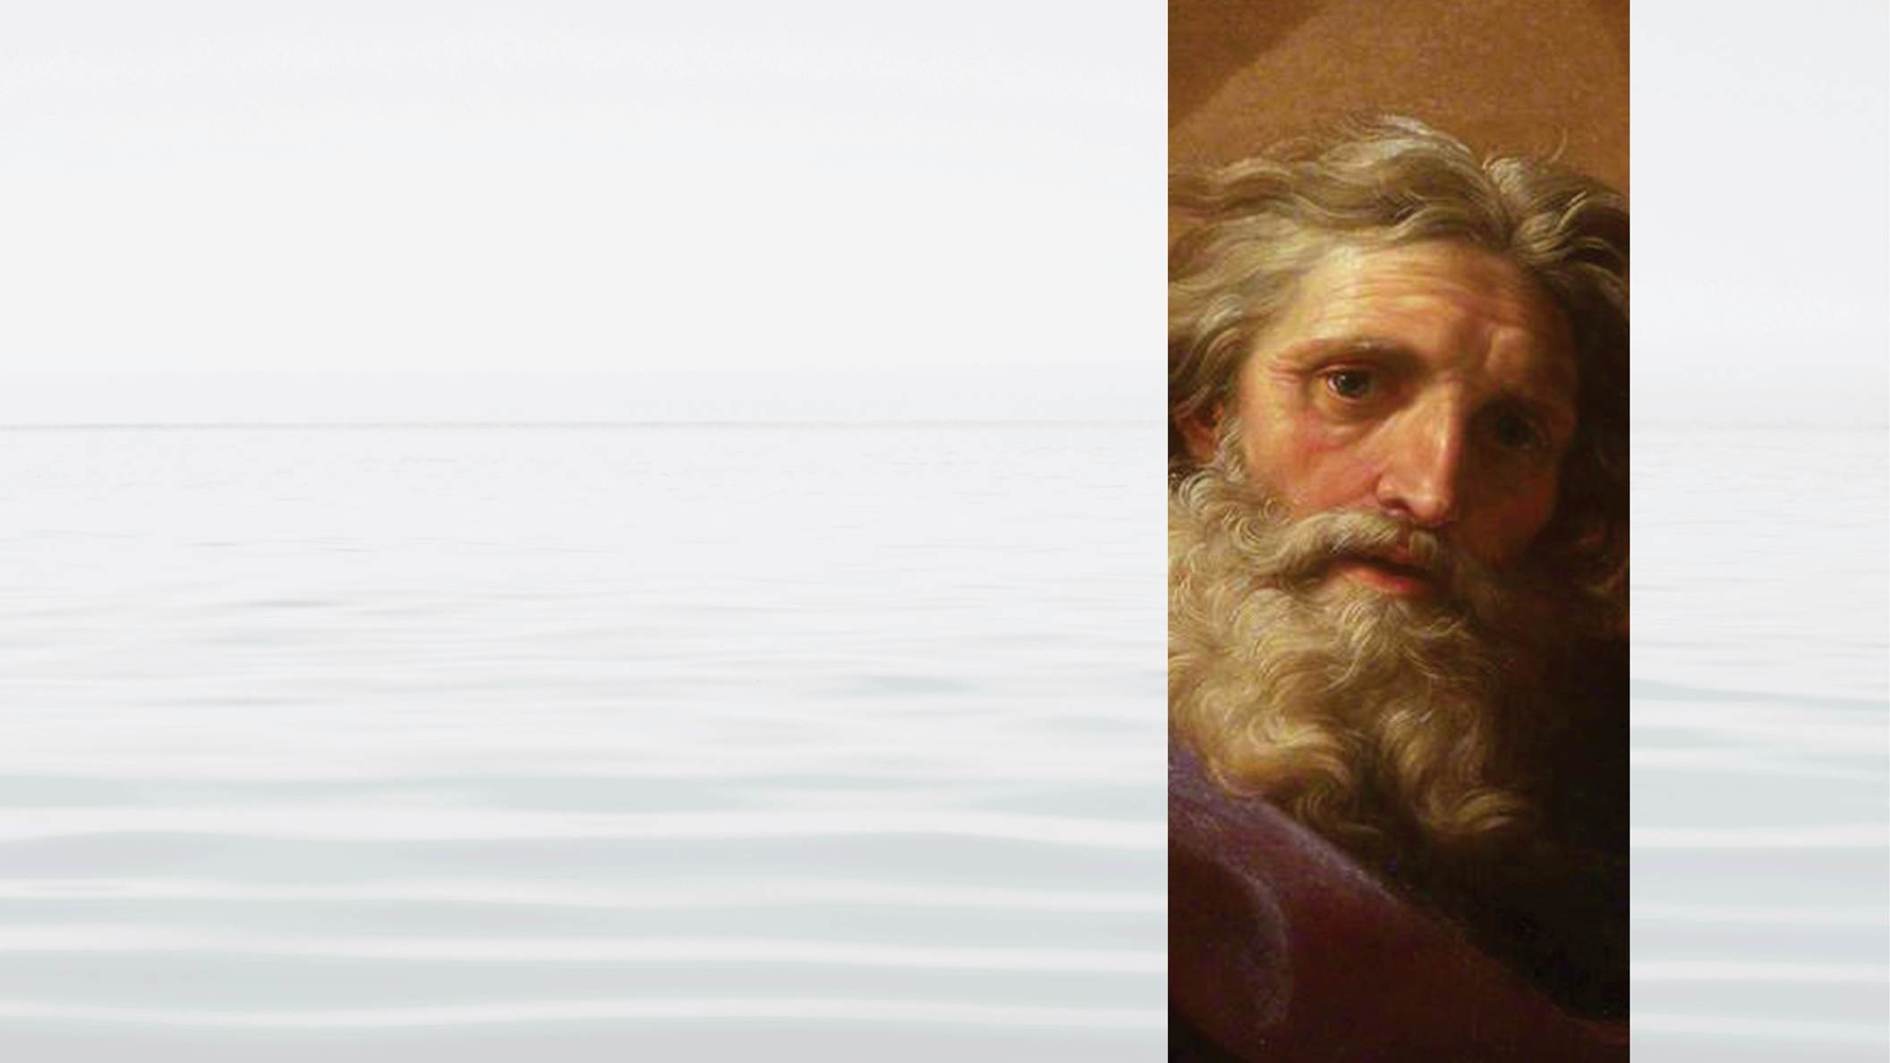
Notes:
invisible God who created the universe. In 1 Corinthians 15:45 Paul said that Jesus is the last Adam. If we understand Jesus to be in the position of Adam, we can understand that he was not the same as God the creator. Like Adam, Jesus was a man born into this world without sin. Just as the first Adam had to grow to be one with God,

Slide 27
Notes:
Jesus also had to grow to become God’s son. Hebrews 5:8 states that “he learned obedience through what he suffered.” Like Adam, Jesus was a man who was tempted by sin. But unlike Adam, Jesus overcame temptation and became one in heart with God. He succeeded in becoming the person whom God could proclaim was God’s son, the son in whom God was “well pleased.”

Slide 28
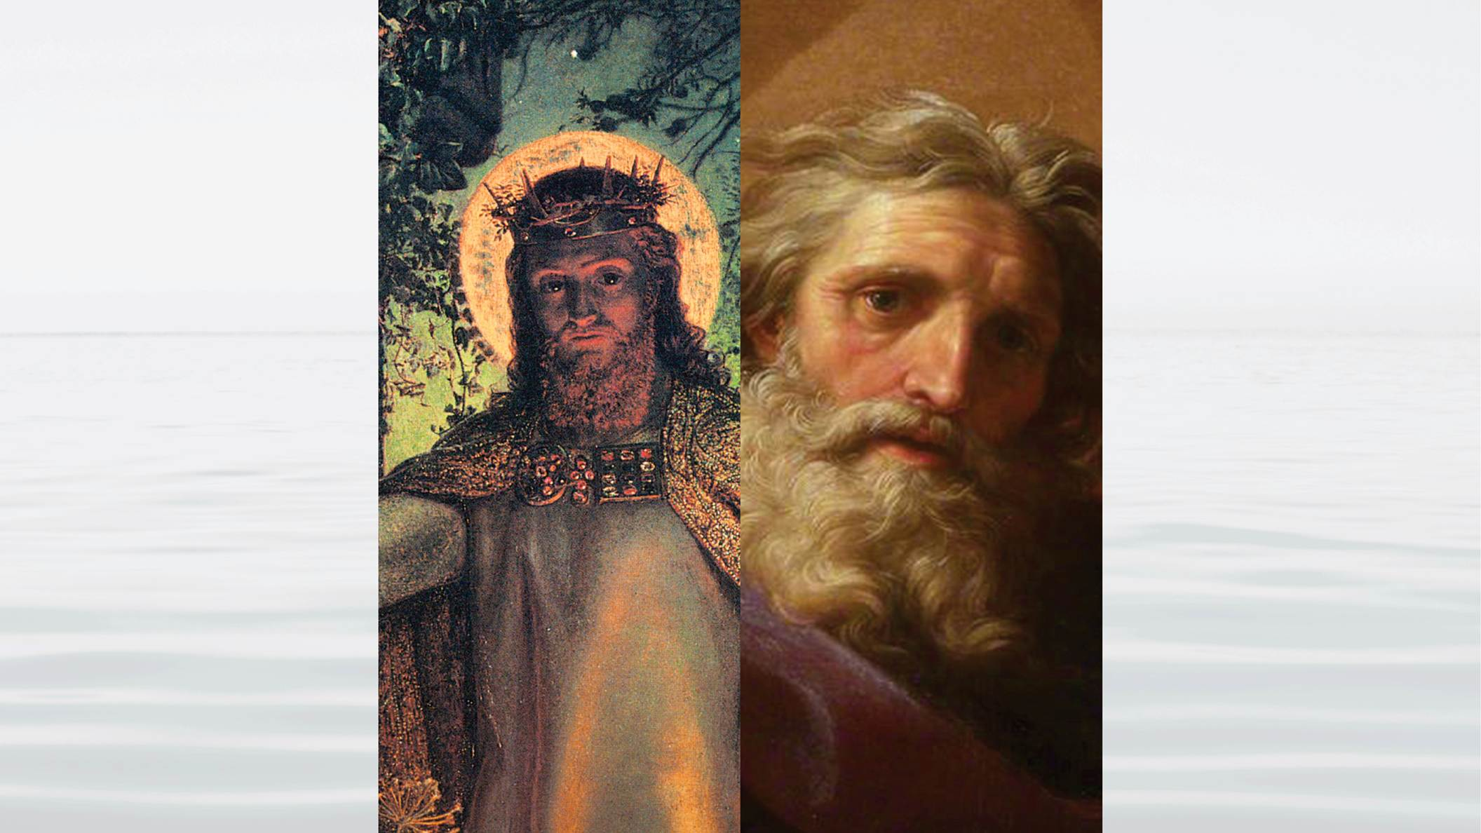
Notes:
In John 14:11 Jesus said that he and God are one, and in that sense we can say that he is God or the visible expression of God’s will and God’s heart. But we should not forget that Jesus, in John 14:20

Slide 29
Notes:
taught that we are all to become one in heart with God.
Jesus and God are not the same being. We know this because Jesus himself, referring to the Second Coming of the Messiah, said in Matthew 24:36 that there were things God knew that he did not know.
But more important than a few biblical passage, there is a clear reason why Jesus cannot be God and why he must be a man.

Slide 30
Notes:
Romans 5:19 For as by one man’s disobedience many were made sinners, so by one man’s obedience many will be made righteous.
Only a man can fix the mistake that the man Adam committed in the fall, God is not able to do so.
This is because God did not fall. The fall did not take place in the realm of

Slide 31
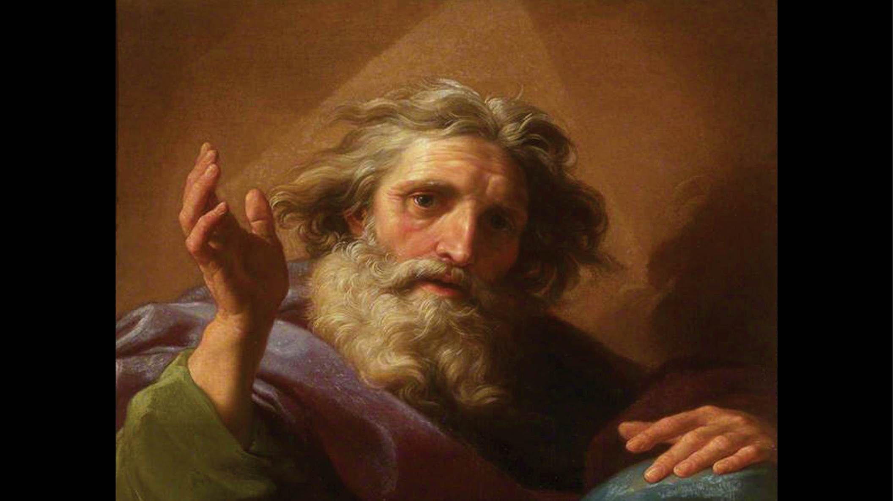
Notes:
God’s portion of responsibility. God did not leave us. Rather a man and a woman left God by their own free choice. It took place in their realm of responsibility. Therefore God cannot fix what happened. A man and woman must do that.
Think about it. If the fall were

Slide 32
Notes:
God’s responsibility, and therefore He was responsible for fixing it, He would have fixed it a long time ago. In fact He would never have let it happen in the first place.
The only reason God has allowed evil to dominate this world and continue to dominate this world for so long is that it is the direct result of man and woman failing

Slide 33
Notes:
in their responsibility.

Slide 34
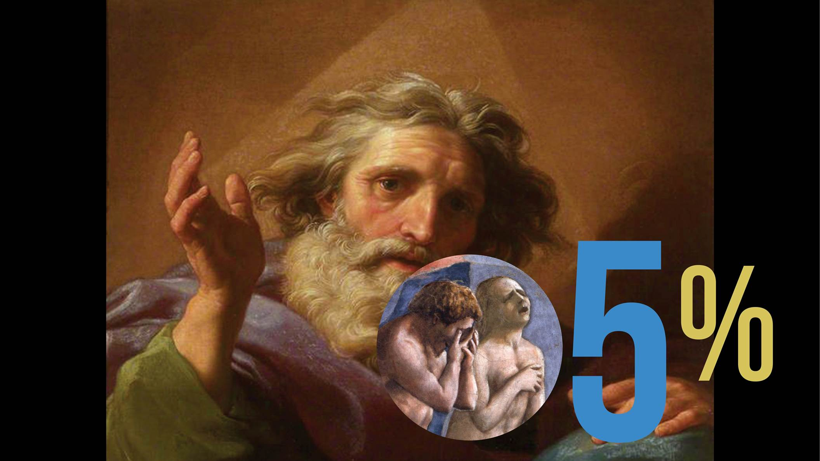
Notes:
Adam made the mistake – therefore, to restore that mistake, there needs to be another Adam.

Slide 35
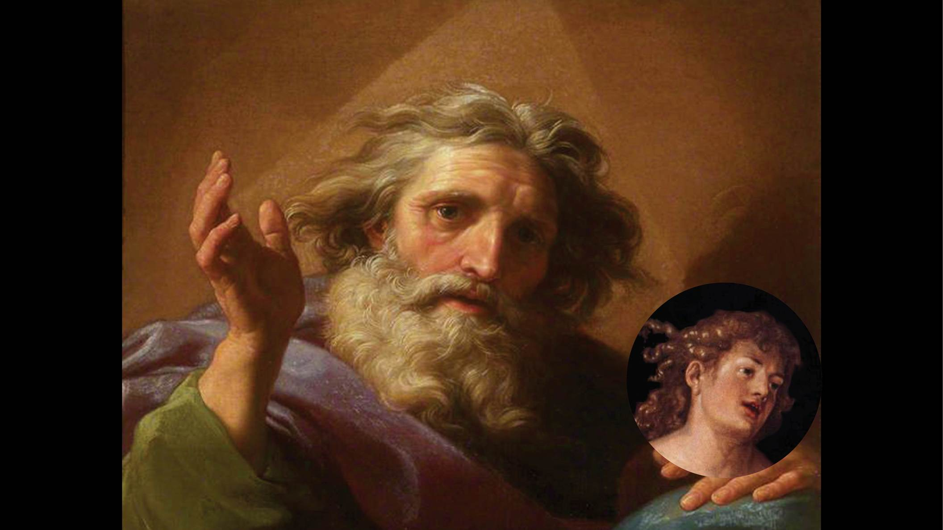
Notes:
Jesus is that person, born to be the new Adam.
How could the messiah, Jesus, save humanity? He does so by coming as a

Slide 36
Notes:
living Messiah, received by God’s chosen people, the Israelites. As the living Messiah, he stands as

Slide 37
Notes:
the new Adam who is able to find

Slide 38
Notes:
the New Eve, the woman who has the mission to fix the mistake of the first Eve.
This woman, by following Jesus’ guidance, was to become God’s true daughter. This is why in Matthew 9:15 Jesus referred to himself as

Slide 39
Notes:
the bridegroom. He was coming to find his bride.
If God’s ideal is the family, you can’t start a family with just a man. The image of God, as stated in Gen 1:27 is

Slide 40
Notes:
a man and woman. Jesus alone could not fully reflect God’s nature. He needed a woman to do that, and he needed a woman in order to

Slide 41
Notes:
form a family.
If Jesus had been accepted as the Messiah,

Slide 42
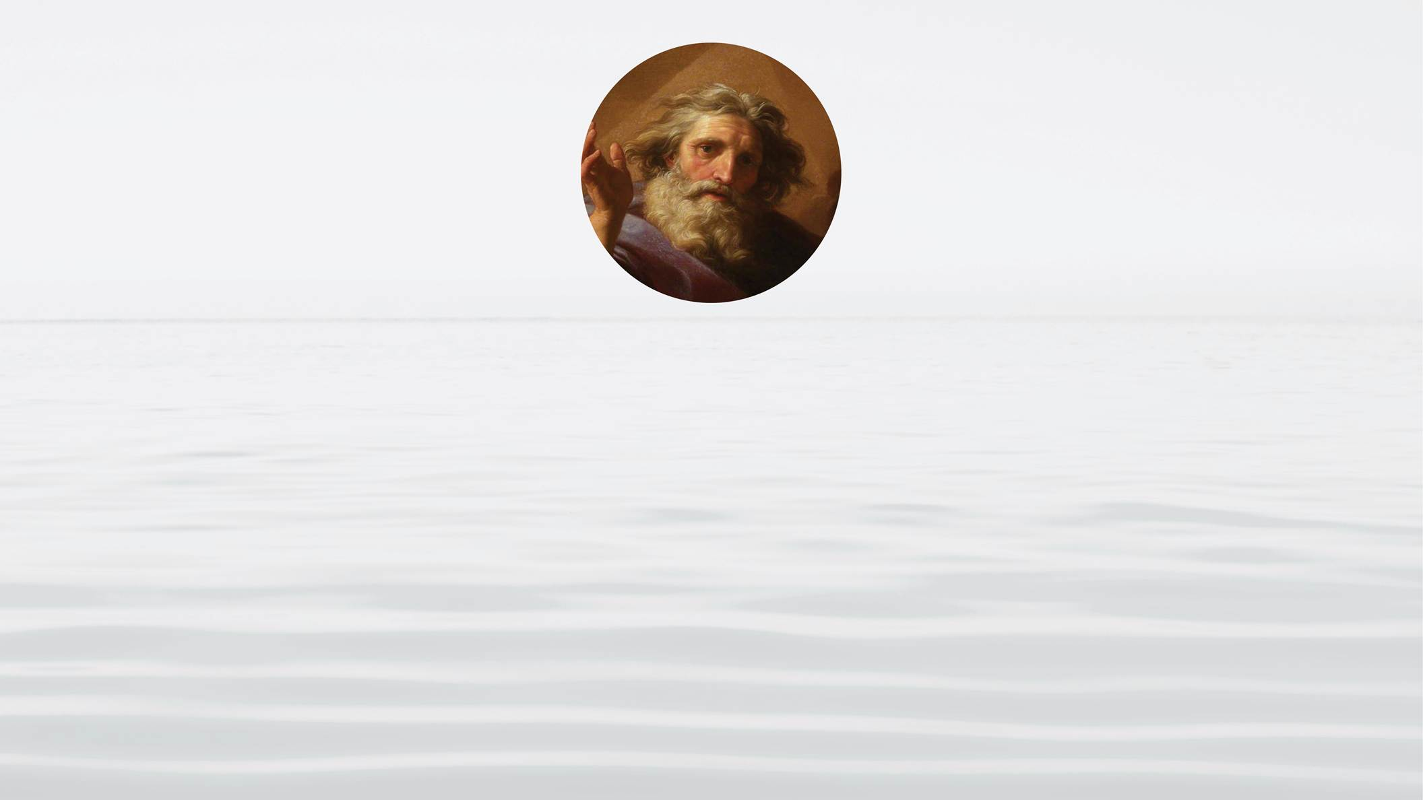
Notes:
God would have blessed

Slide 43
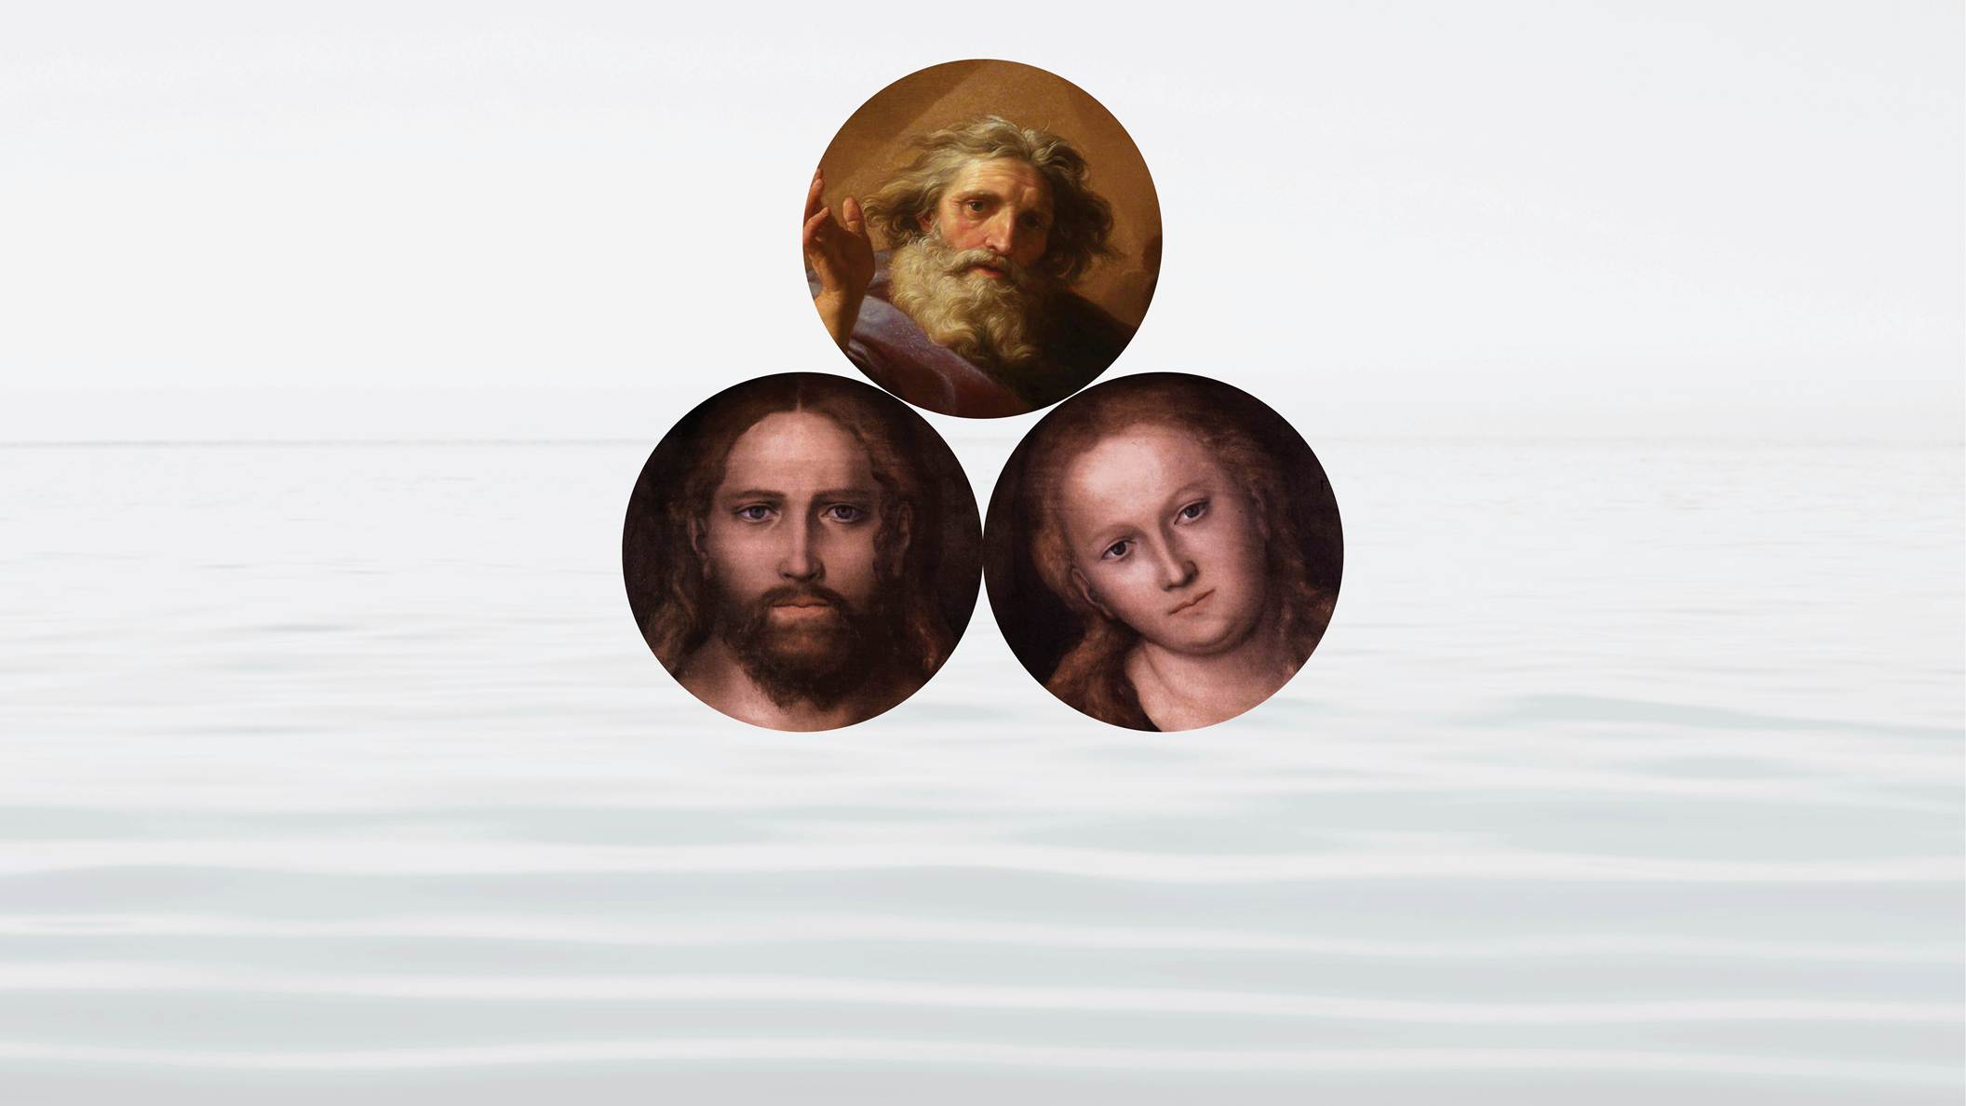
Notes:
Jesus and his bride together in marriage, fulfilling the original purpose of creation. Together they would have

Slide 44
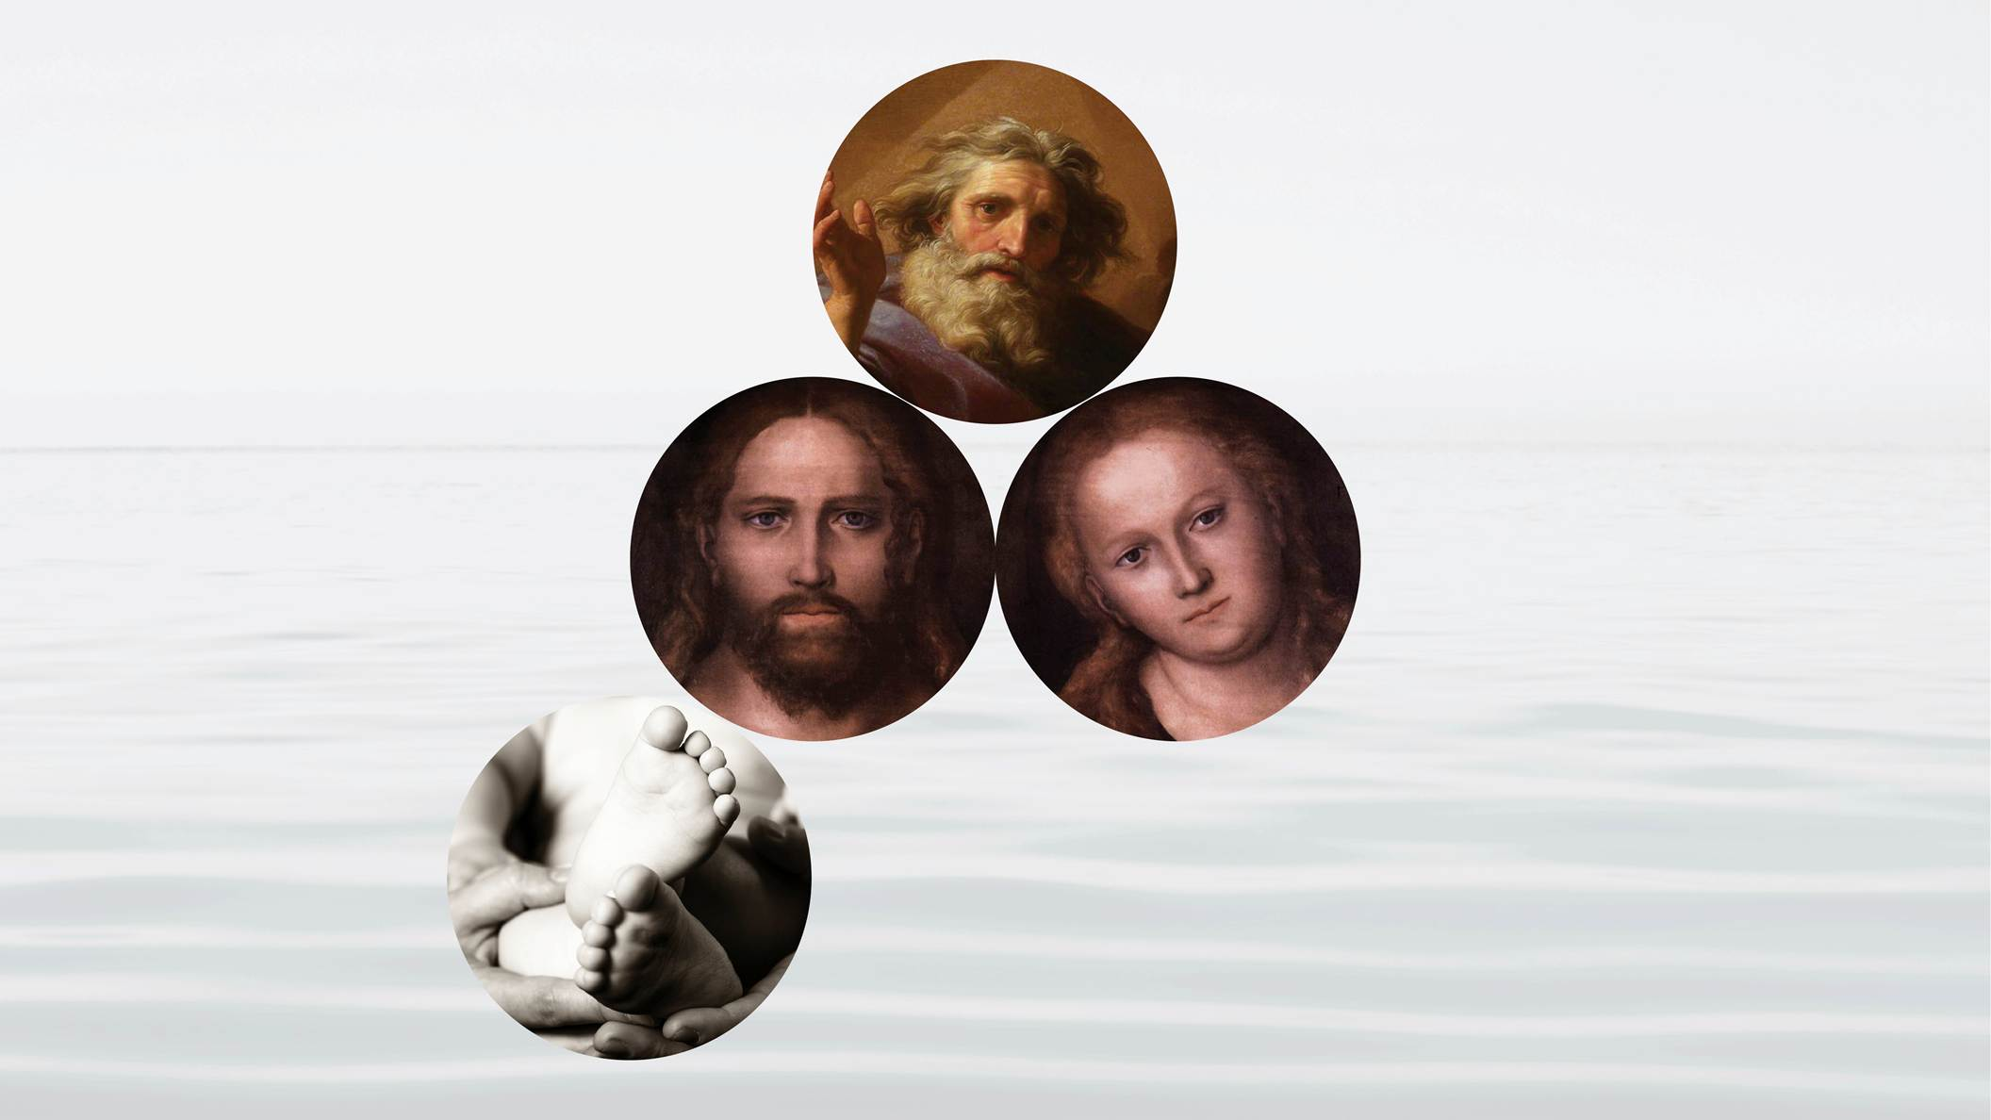
Notes:
given birth to children born directly from God’s love. Not only would they have given birth to their own children, but also through their family they would have been able to

Slide 45
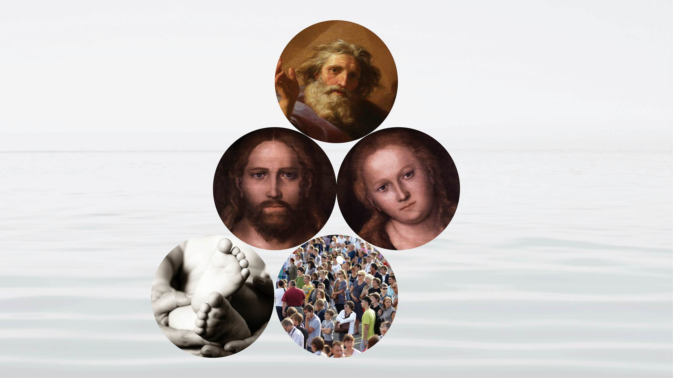
Notes:
give rebirth to all humanity. In Paul’s words, (Romans 8:23) all humanity would have been able to be adopted into God’s family of love. In this way

Slide 46
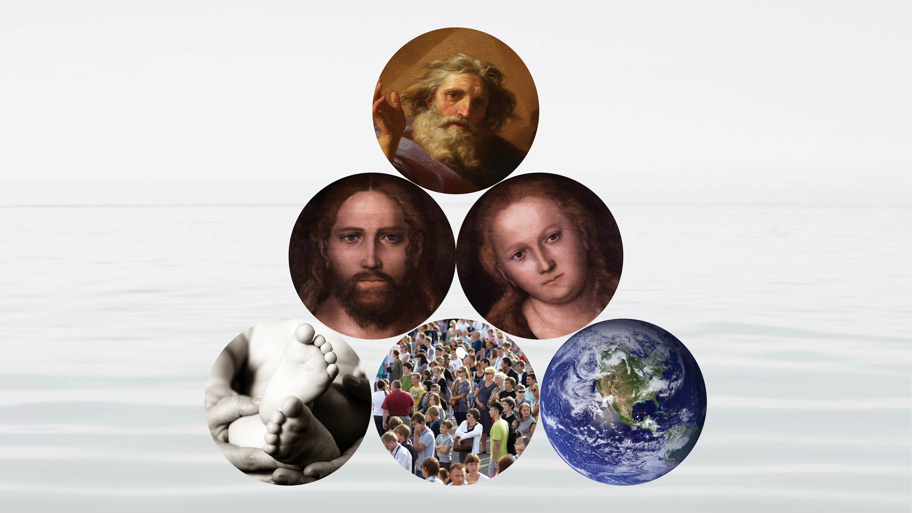
Notes:
the Kingdom of God on earth would be restored.
Sadly Jesus was not accepted. He was crucified. Jesus was God’s true son, but he was murdered by the sinful world and that is why he

Slide 47
Notes:
could not find his bride, nor could he create God’s family.
Nevertheless, because of his victory of love on the cross, because he offered his life to save humanity, God could resurrect Jesus. It is the resurrected Jesus, working together with God’s spirit, what is called

Slide 48
Notes:
the Holy Spirit, that enables us to receive rebirth as Christians. Jesus and the Holy Spirit are like Spiritual Parents giving spiritual rebirth to all who love Jesus, who follow his teachings, and who believe that he has the authority to forgive sins.
But rebirth through Jesus and the Holy Spirit, is not enough

Slide 49
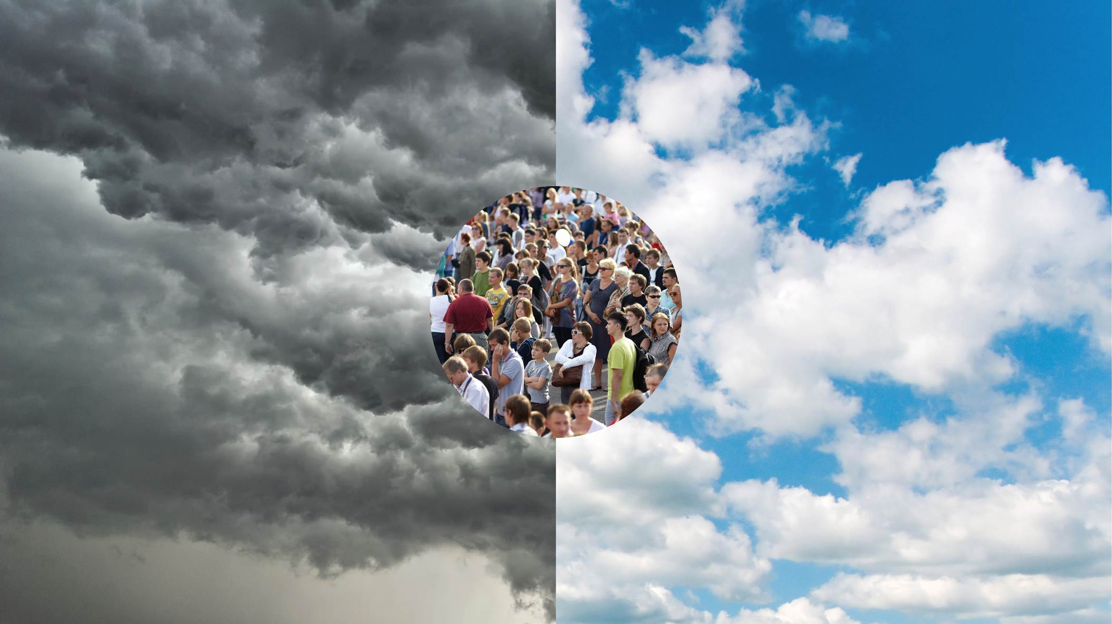
Notes:
it does not change our connection to the lineage of sin that was started at the time of the fall by Adam and Eve. When a Christian family has a child, its birth is no different from any other child born into this world. It is not born as a pure son or daughter of God, like Jesus was.
This is why, in our present world, through our religious

Slide 50
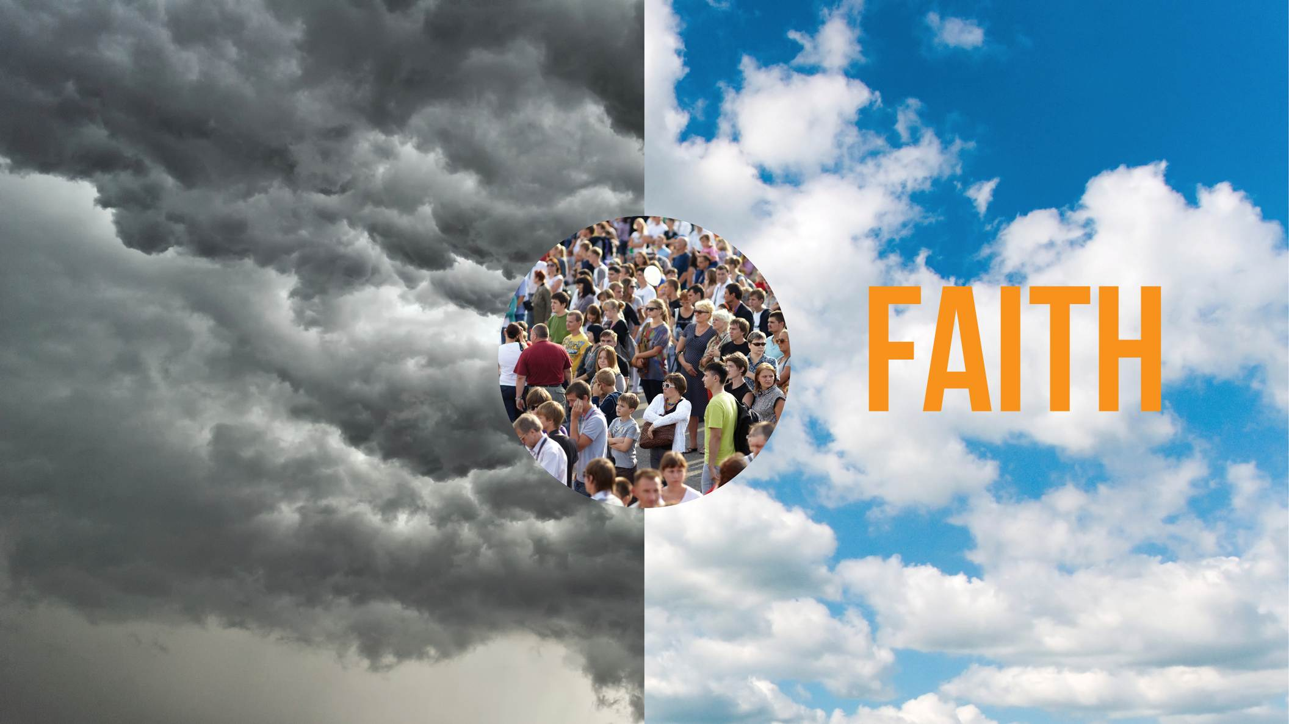
Notes:
faith, we can experience God through faith, but we do not experience God’s direct love and presence in our lives. This world continues to be dominated by

Slide 51
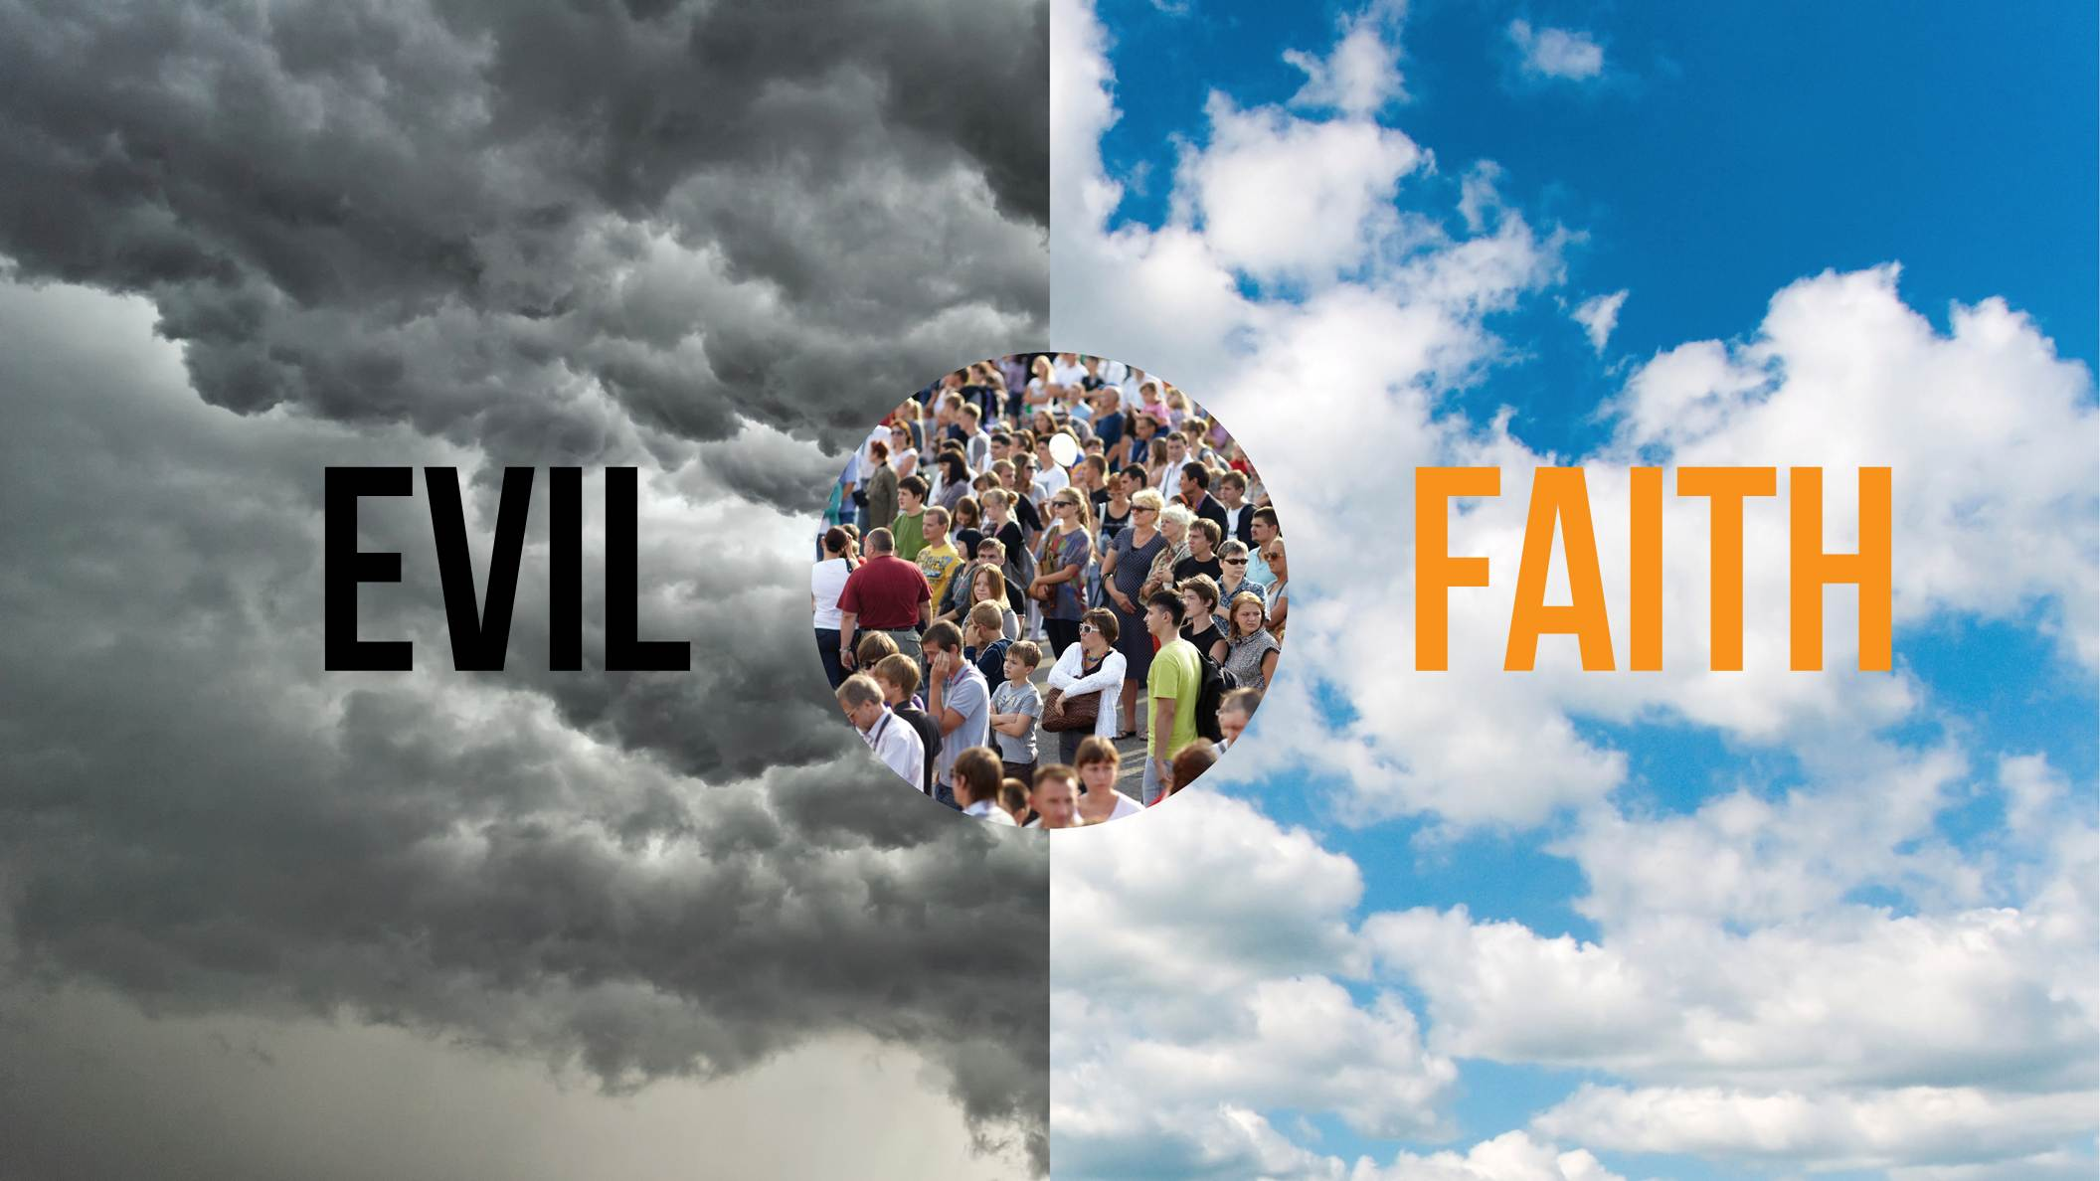
Notes:
evil.
All denominations of the Christian faith recognize this reality. Their children are born into sin just like any other child. They also, like their parents, need to be saved, they need to be reborn in order to connect with God.
This is why the Messiah needs to come again. In fact we learned in the previous session that the Messiah is already here.
We have

Slide 52
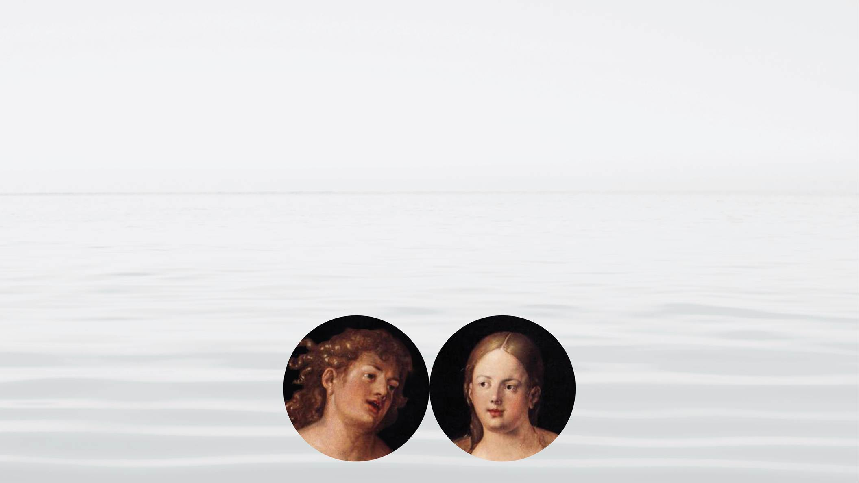
Notes:
the first Adam and Eve, who corrupted the human family through a false relationship of love. Then we have

Slide 53
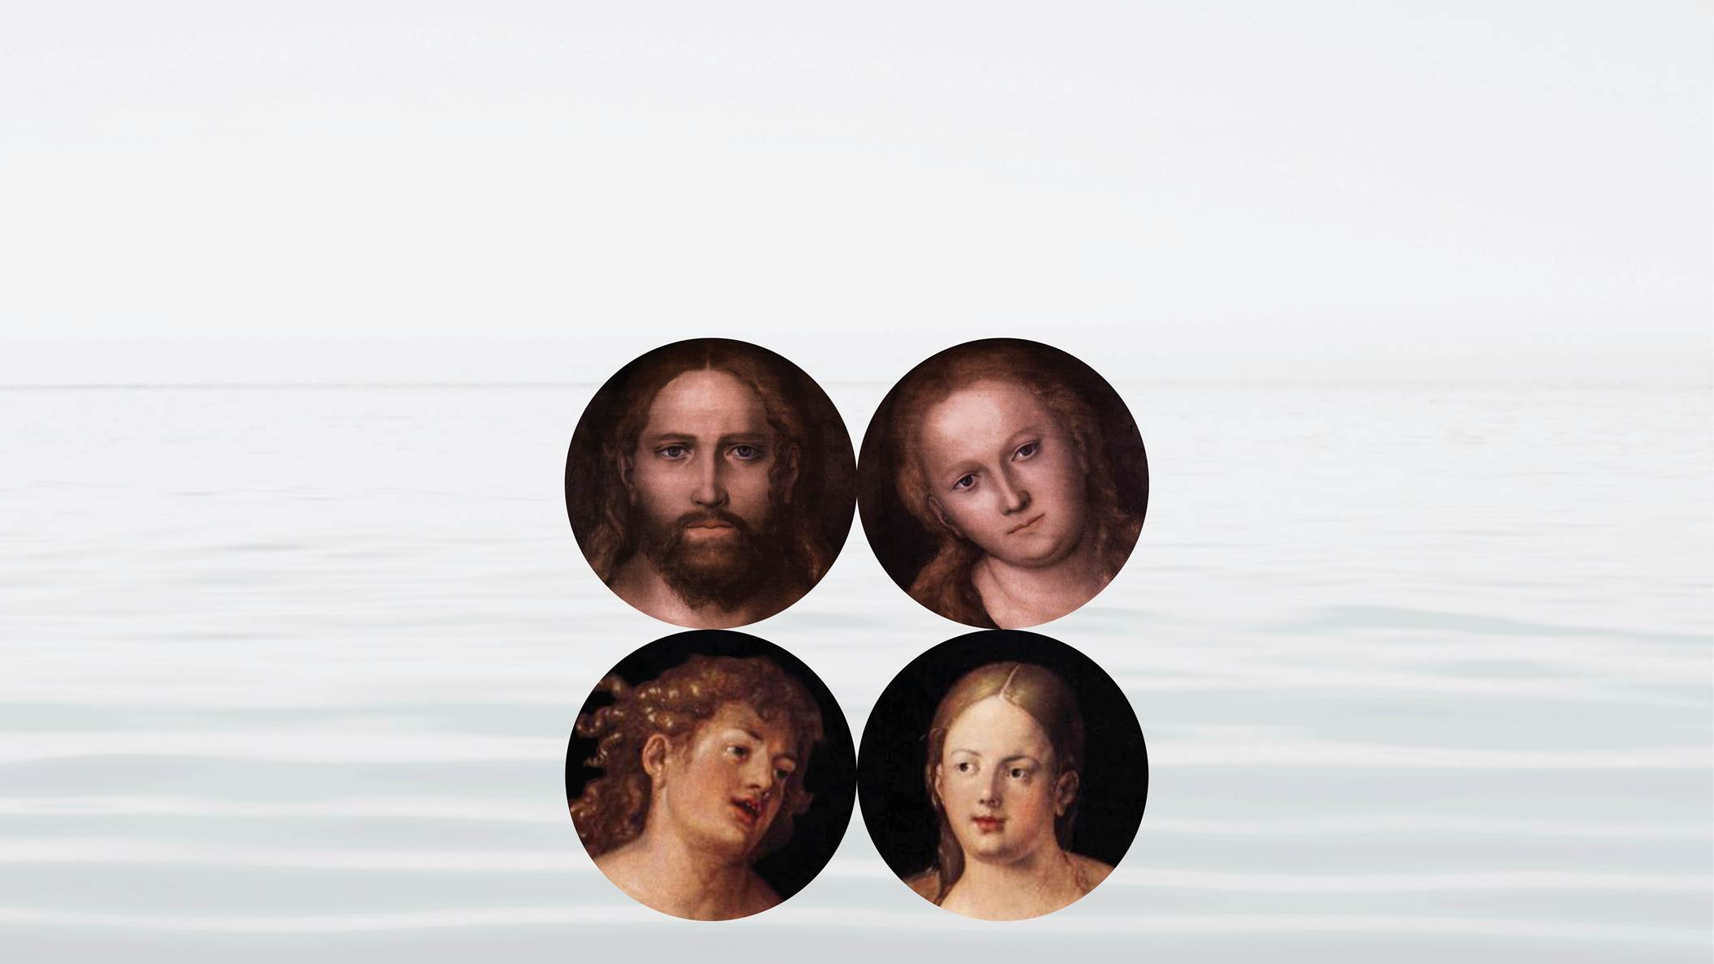
Notes:
Jesus, the 2nd Adam who, after his crucifixion, was resurrected and together with the Holy Spirit is giving rebirth in the Christian faith. This has allowed People to experience God through faith, but we are unable to realize God’s ideal in our families or in the greater society.

Slide 54
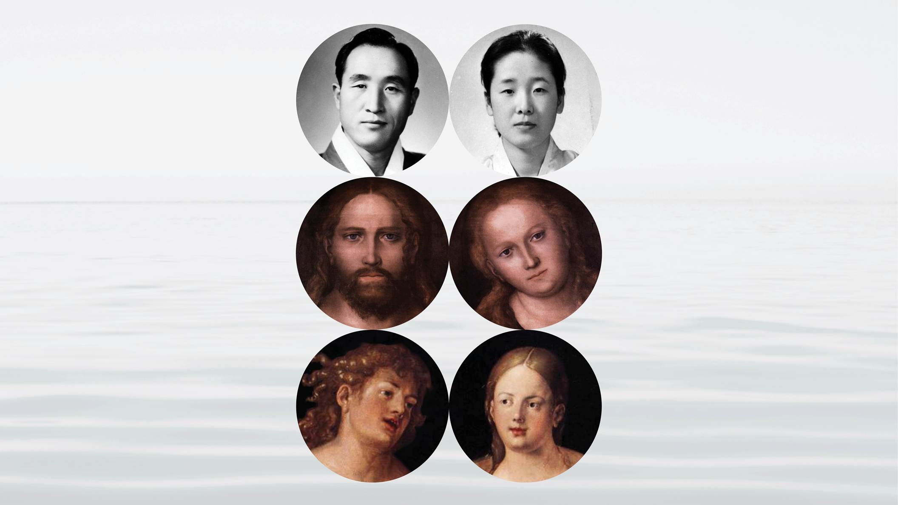
Notes:
Now, God has sent the 3rd Adam, or the 2nd Messiah to finally fulfill God’s will on the earth. This time, although he has been greatly misunderstood and although he has been to prison 6 times, including over 2 years in a N Korean Concentration camp, he was not killed. This time he has found his bride and together they have established God’s family.
Let’s assume that the Messiah is here – what should we expect to see him do?

Slide 55
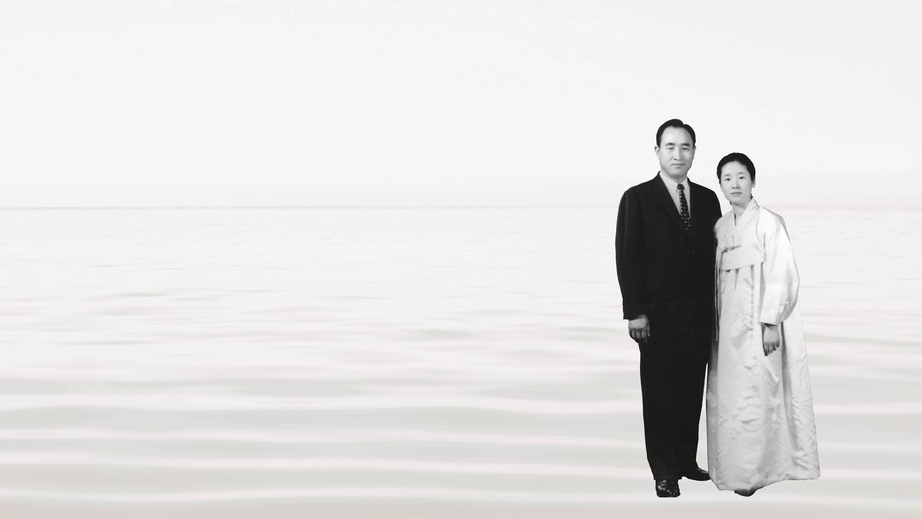
Notes:
Well, to begin with, he is not going to appear as an individual – this time the Messiah is going to appear with his bride. He will fulfill the Biblical prophecy in Revelations 19:6-7 “Hallelujah! For the Lord our God the almighty reigns. Let us rejoice and give him the glory, for the marriage of the Lamb has come, and his bride has made herself ready.”
Rev Moon and his bride, Hak Ja Han Moon were blessed in marriage in 1960.

Slide 56
Notes:
This is the breaking news, that the marriage of the lamb has taken place.
What else should we expect? He and she will bring the truth that will bring all humanity

Slide 57
Notes:
out of our state of ignorance.
They will reveal to all humanity the true reason we are distant from God. They will expose the tragedy of the first family and the fact that our birth was not rooted in God’s ideal of love. They will reveal the true mission of Jesus. They will show how God has been working through history to finally restore the original ideal of creation on this earth.

Slide 58
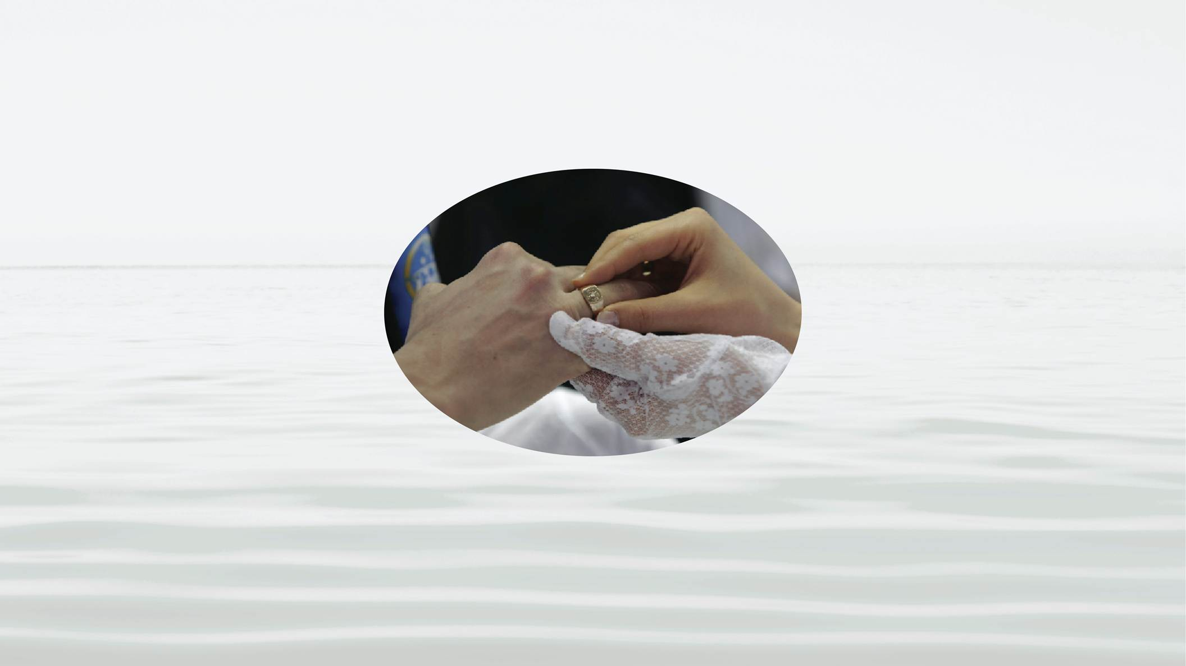
Notes:
This is in fact the content that we have been sharing with you from the Divine Principle, the revelation which Rev Moon received from God
Finally, this couple is going to announce to the world that they are the True Parents and as the True Parents they will proclaim the establishment of God’s family. In addition they will invite all the people of the world to join with them, to become members of God’s family.

Slide 59
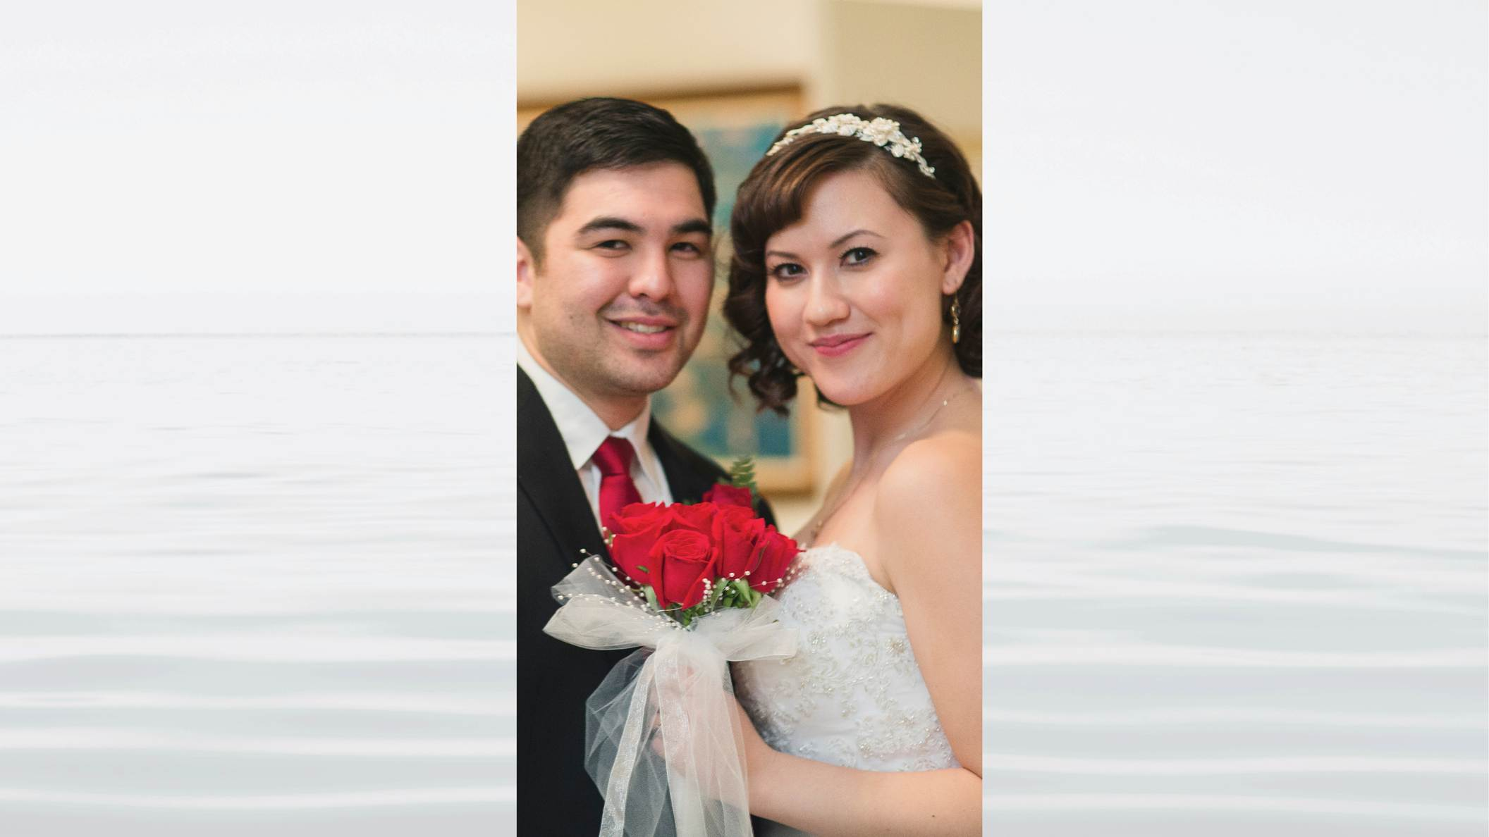
Notes:
How will humanity become a part of God’s family? It is not complicated. In biblical terms, they are going to invite all people to the marriage of the lamb. The marriage of the lamb is not only for the Messiah, it’s for all people.

Slide 60
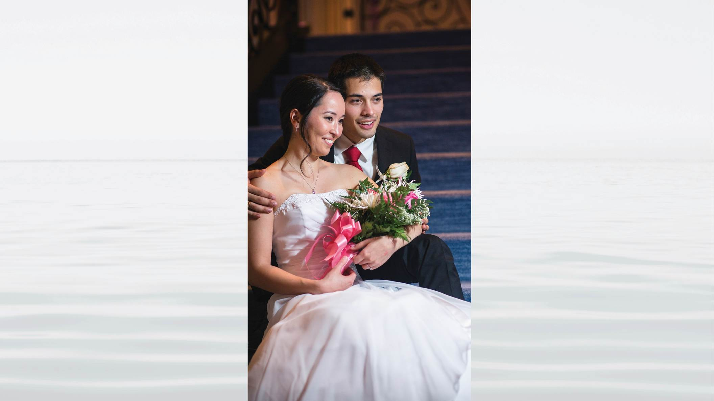
Notes:
All people were designed by God to relate to an eternal spouse and with that spouse to fulfill the ideal of creation.
Every man has the potential to stand as a true Adam and every woman has the potential to stand as a true Eve.
Our first ancestors left God as a couple. To fix that, the Messiah and his bride will invite all people to return to God as couples.

Slide 61
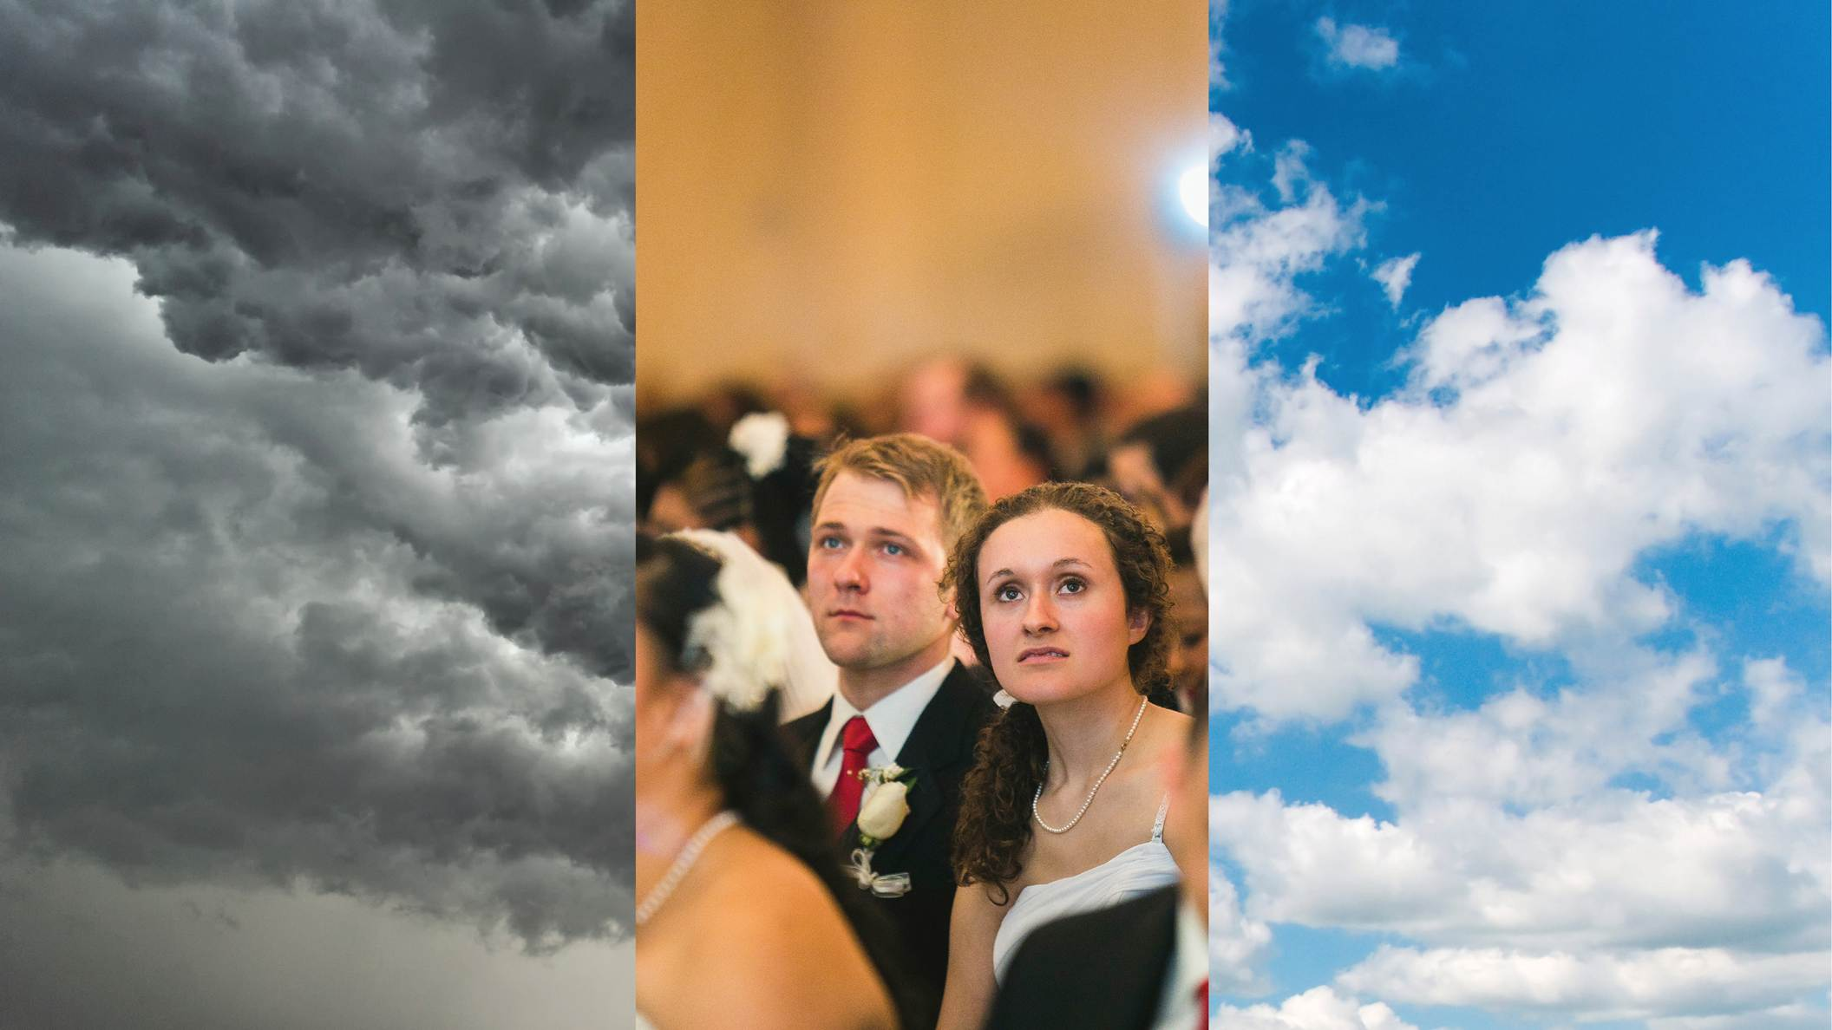
Notes:
For that purpose the Messiah and his bride are conducting special ceremonies, marriage blessing ceremonies in which couples receive God’s Blessing. In this ceremony, before God and the entire world, couples make the determination that they will be responsible members of God’s family and that they will work to separate themselves from their sinful past.

Slide 62
Notes:
It is important to note, that this ceremony, although it is essential to God’s plan for saving humanity, by itself it is not a magical solution to the problems of the world. It is a ceremony that cuts our ties to the fallen family that the Archangel initiated – but it does not erase all our problems, our bad habits.

Slide 63
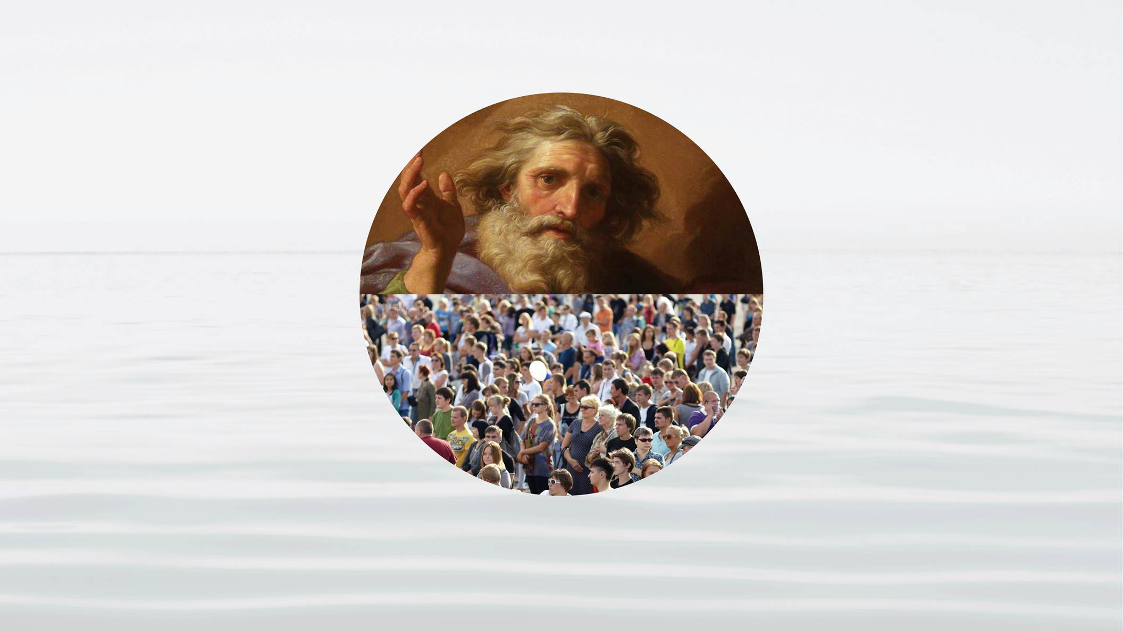
Notes:
Everyone who comes to God, no matter what their past mistakes may be, is welcomed by God. But God knows that we will each bring with us a lot of unwanted baggage. Therefore, along with the Blessing ceremony, the Messiah and his bride are investing all their energy to provide us with the guidance we need in order to take responsibility for the wounds and mistakes of the past and build a new life and a new culture that is centered on God’s heart.
If you are single and would like to participate in the Blessing –

Slide 64
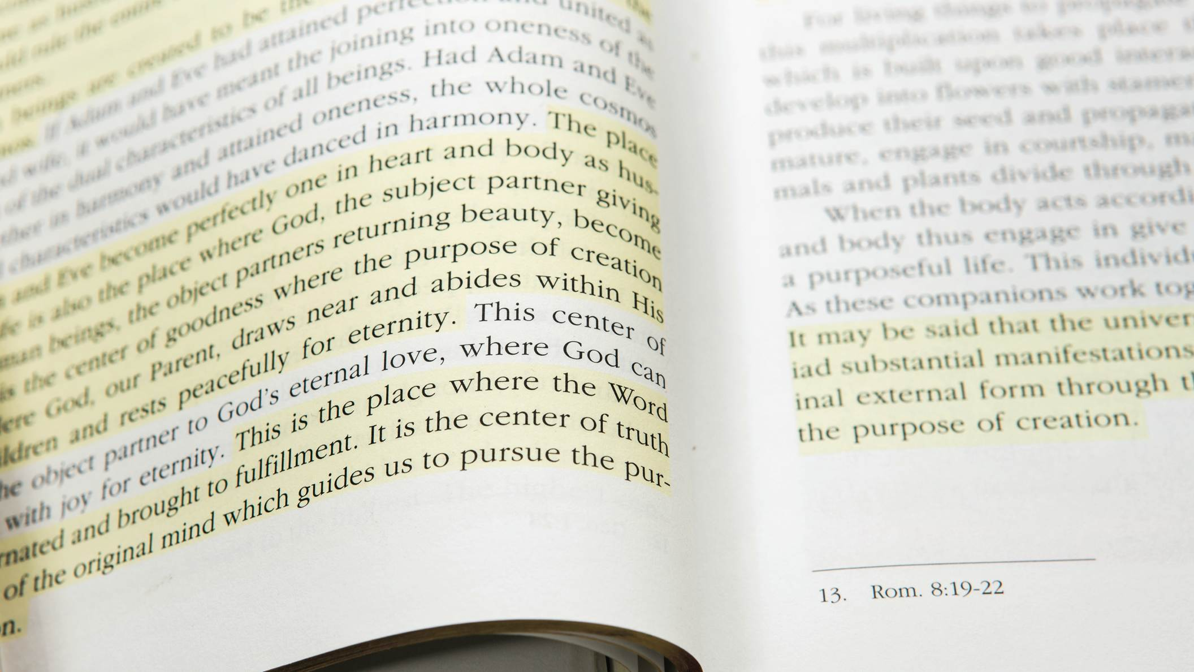
Notes:
we invite you to first continue to study the Divine Principle more deeply.
If you are already married, we also invite you to come to the Blessing ceremony as a previously married couple. Before doing that we encourage you to study the content of the Divine Principle– and learn more about what it means to take responsibility as a member of God’s family.

Slide 65
Notes:
Either way, we invite you to get involved with others who are studying the Divine Principle in your local area. Contact us and we can put you in touch with them.
Think about it, and pray about it – wouldn’t it be wonderful, to be able to form a family that is blessed by God, that is on the path, together with families from all around the world –working to realize a world of peace, freedom, and happiness that is rooted in the love of God.

Slide 66
Notes:
Thank you for joining us.
If you have questions, please contact us.
God Bless you!

